Slide 1
Bundle Adjustment
Math Reading
Seminar
Thing
LukášP

Slide 2
Talk structure
3D geometry
Projective geometry
Problem Statement
Minimum Geometric Problems
Least squares, Moore-Penrose pseudoinverse, SVD
Nonlinear Least Squares
Intermezzo I – computing derivatives
  Symbolic / Numerical differentiation
  Dual numbers
  Lie groups basics
Handling Severe Nonlinearity
  Levenberg Marquardt
  Dogleg
Handling outliers – robust estimation
Intermezzo II – solving linear systems
  Direct methods
  Schur complement trickery
  Iterative methods
  Inexact step NLS
Calculating covariances

Slide 3
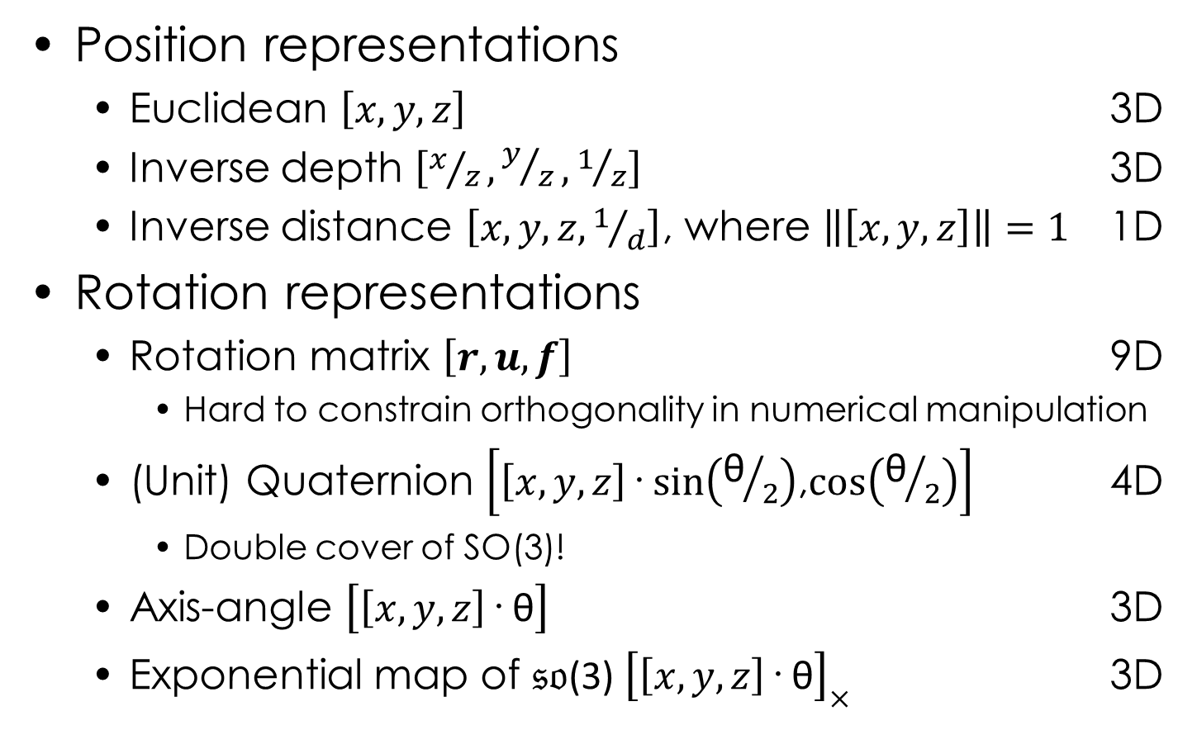
3D Geometry
Position representations
  Euclidean $\left[x, y, z\right]$ 3D
  Inverse depth $\left[x/z,y/z,1/z\right]$ 3D
  Inverse distance $\left[x, y, z,1/d\right]$, where $\left\|\left[x, y, z\right]\right\|=1$ 1D
Rotation representations
  Rotation matrix $\left[r, u, f\right]$ 9D
    Hard to constrain orthogonality in numerical manipulation
  (Unit) Quaternion $\left[\left[x, y, z\right]\text{·} sin\left({\text{θ}}/2\right)\text{,} \text{cos}\left({\text{θ}}/2\right)\right]$ 4D
    Double cover of SO(3)!
  Axis-angle $\left[\left[x, y, z\right]\text{·} \text{θ}\right]$ 3D
  Exponential map of $𝔰𝔬$(3) ${\left[\left[x, y, z\right]\text{· }\text{θ}\right]}_{×}$ 3D

Slide 4
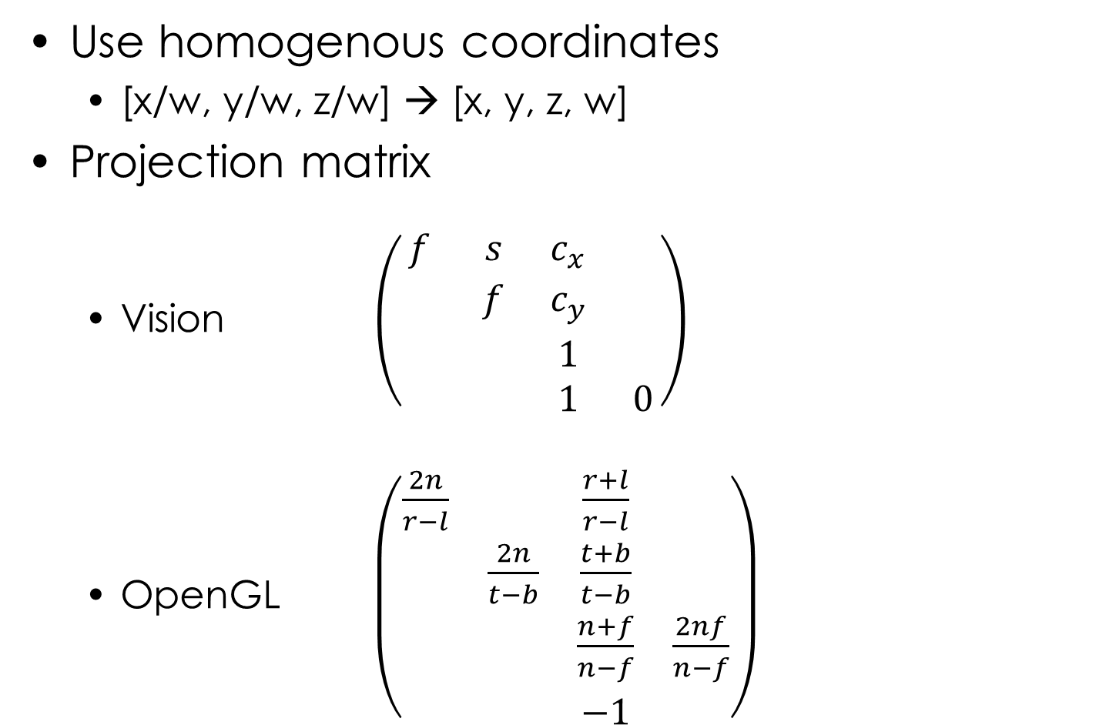
Projective Geometry
Use homogenous coordinates
  [x/w, y/w, z/w] → [x, y, z, w]
Projection matrix
  Vision $\left(\begin{matrix}f & s & c_{x} & \\ & f & c_{y} & \\ & & 1 & \\ & & 1 & 0\end{matrix}\right)$
  OpenGL $\left(\begin{matrix}\frac{2n}{r−l} & & \frac{r+l}{r−l} & \\ & \frac{2n}{t−b} & \frac{t+b}{t−b} & \\ & & \frac{n+f}{n−f} & \frac{2nf}{n−f} \\ & & −1 & \end{matrix}\right)$
We‘re not interested in the w coordinate (it is „always“ 1).
Leads to division by depth.

Slide 5
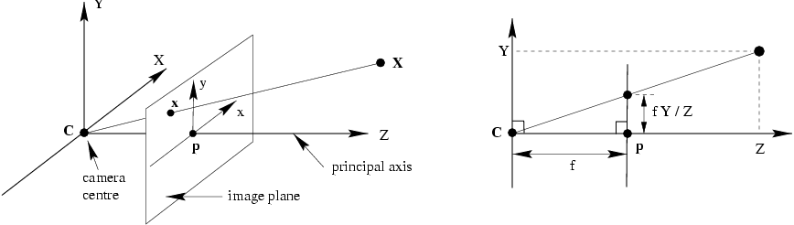
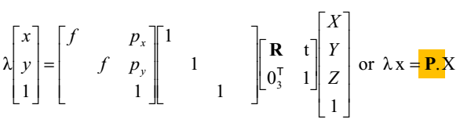
Pinhole Camera Model
Stolen from Bronek Pribyl‘s VGE lecture (I think)
principal axis
camera
centre
image plane
dimension
wrangling
magic
intrinsics K
pose
x
P
= K [R t]
X

Slide 6
Other Camera Models
Spherical
Curvilinear
Catadioptric
…

Slide 7
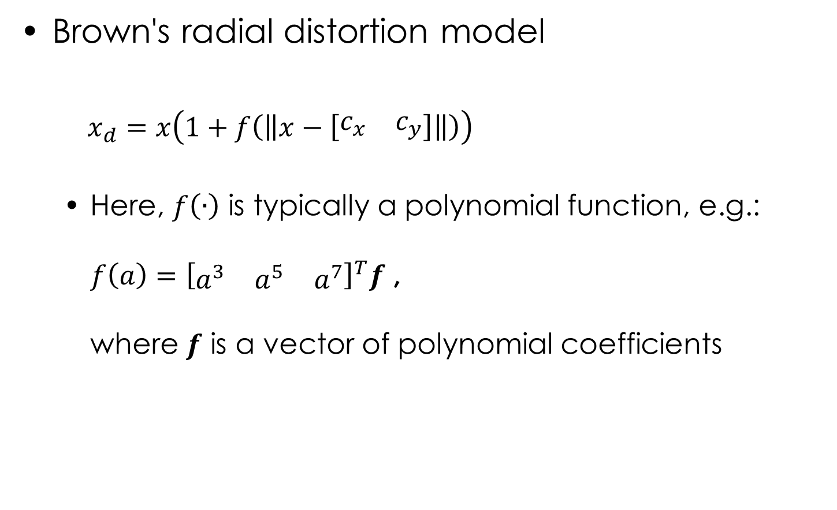
Lens Distortion Models
Brown's radial distortion model
  $x_{d}=x\left(1+f\left(\left\|x−\left[\begin{matrix}c_{x} & c_{y}\end{matrix}\right]\right\|\right)\right)$
  Here, $f\left(∙\right)$ is typically a polynomial function, e.g.:
  $f\left(a\right)={\left[\begin{matrix}a^{3} & a^{5} & a^{7}\end{matrix}\right]}^{T}f$ ,
  where $f$ is a vector of polynomial coefficients

Slide 8
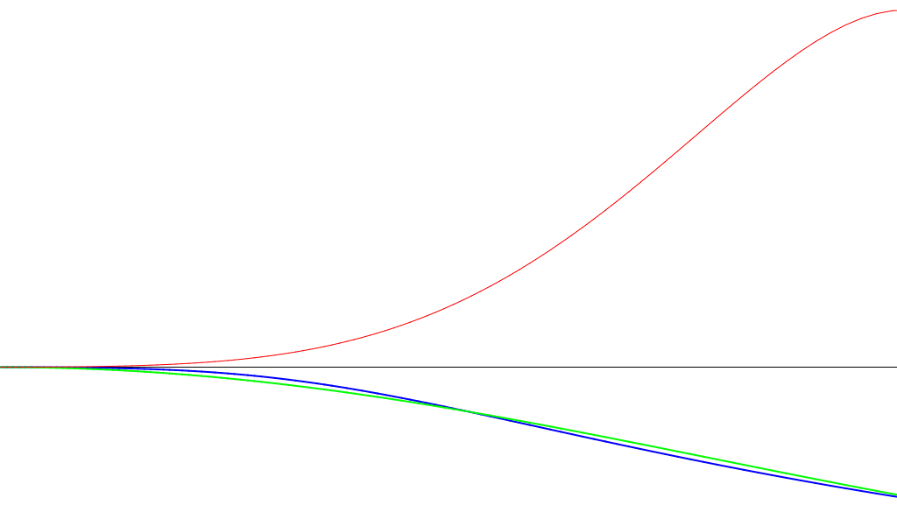



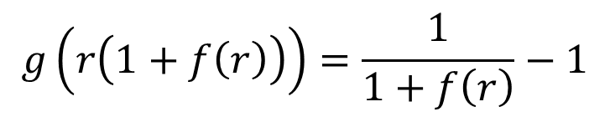

Lens Distortion Models
Problem with invertibility of polynomial $f\left(∙\right)$
Use analytical solution for low degrees
Otherwise use gradient descent
$$f\left(r\right)$$
$$r=\left\|x−\left[\begin{matrix}c_{x} & c_{y}\end{matrix}\right]\right\|$$
$$g\left(r\left(1+f\left(r\right)\right)\right)=\frac{1}{1+f\left(r\right)}−1$$
$$g\left(r\right)$$

Slide 9
Problem Statement
Bundle Adjustment
  „Having a lot of images of
  a scene, let‘s build a 3D model“
  Sparse approach (bundler)
    Find interest point in the images
    Match the interest points
    Calculate spatial rotation / translation between images
    Triangulate points
  Semi-dense approach (LSD)
    Somehow triangulate points in the first camera pair
    Color the points (from image pixels)
    For following cameras, reproject the 3D points, optimize rotation / translation to minimize color difference
  Dense approach (PMVS / CMVS)

Slide 10
Problem Statement
Bundle Adjustment
  „Having a lot of images of
  a scene, let‘s build a 3D model“
  Sparse approach (bundler)
  Semi-dense approach (LSD)
  Dense approach (PMVS / CMVS)
    Solve dense pixel correspondences
    Early methods modifications of dynamic programming
    Gives per-pixel dense depth
      Requires known relative camera poses (ok for stereo)
    Can solve alignment by e.g. Iterative closest point (ICP)

Slide 11
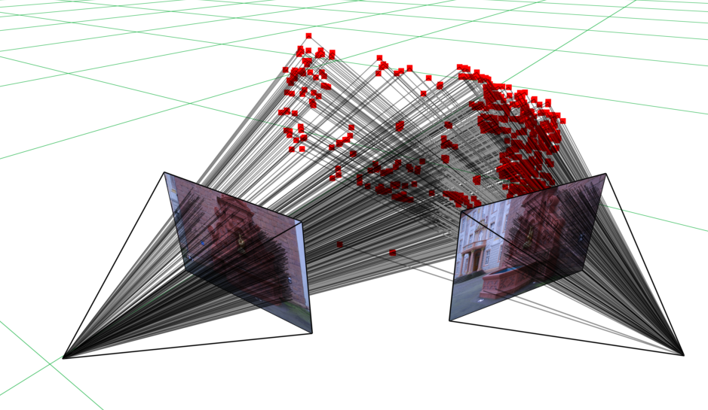
Bundler / Sparse Approach

Slide 12
Minimal Geometric Problems
How do we calculate positions from images?
MGPs! http://cmp.felk.cvut.cz/mini/
(also recent VGS-IT by Tom Pajdla)
Given a bare minimum of data, get solution by applying some geometric constraints

Slide 13
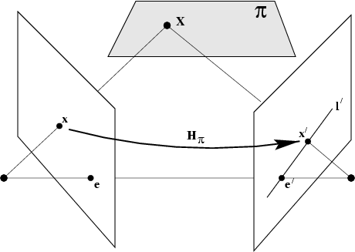
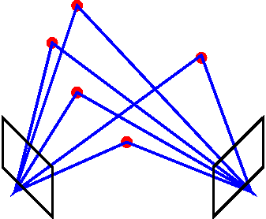




Minimal Geometric Problems
Five-point algorithm [Nister et al. 2004]
  Given five 2D points, find [R t] between the cameras
  Employs Epileptic geometry
    Fundamental matrix F = K₂^{-T}([t]×R)K₁⁻¹ = K₂^{-T}EK₁⁻¹
    Epipolar constraint x‘Fx = 0
    Solve 10th order polynomial meh
    Decompose E to R and t multiple (im)possible solutions
X

Slide 14
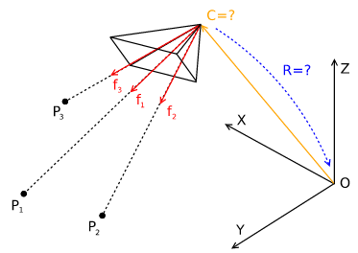
Minimal Geometric Problems
Perspective three Point (P3P) [Kneip et al. 2013]
  Given three 3D points and their 2D observations,
  find [R t] of the observing camera
  From knowledge of K, convert 2D observations to 3D directions
  Leads to quartic equation
  Up to four solutions

Slide 15
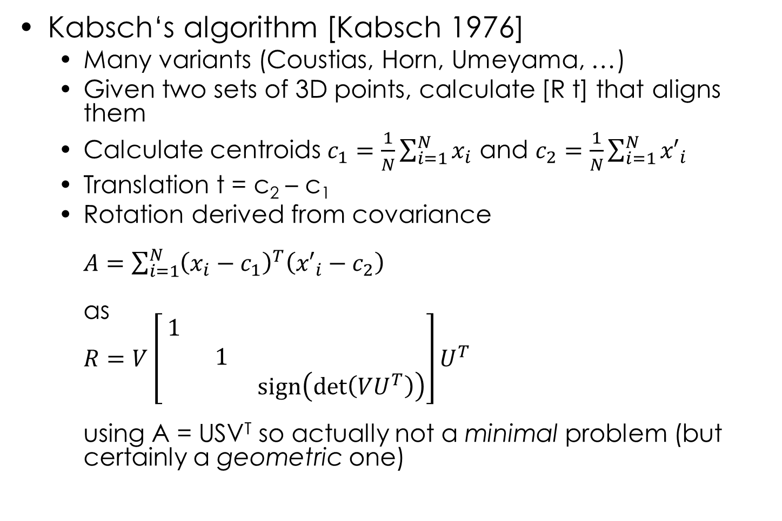
Minimal Geometric Problems
Kabsch‘s algorithm [Kabsch 1976]
  Many variants (Coustias, Horn, Umeyama, …)
  Given two sets of 3D points, calculate [R t] that aligns them
  Calculate centroids $c_{1}=\frac{1}{N}\sum_{i=1}^{N}{x_{i}}$ and $c_{2}=\frac{1}{N}\sum_{i=1}^{N}{{x′}_{i}}$
  Translation t = c₂ – c₁
  Rotation derived from covariance
  $A=\sum_{i=1}^{N}{{\left(x_{i}−c_{1}\right)}^{T}\left({x′}_{i}−c_{2}\right)}$
  as
  $R=V\left[\begin{matrix}1 & & \\ & 1 & \\ & & \text{sign}\left(\text{det}\left(VU^{T}\right)\right)\end{matrix}\right]U^{T}$
  using A = USV^{T} so actually not a minimal problem (but certainly a geometric one)

Slide 16
BA Using Minimal Geometric Problems
Use 5-point algorithm to get [R t] of the first two cameras
Keep using P3P for each consecutive camera
Keep aligning and concatenating

Slide 17
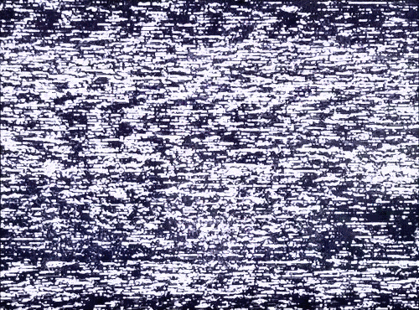

BA Using Minimal Geometric Problems
Use 5-point algorithm to get [R t] of the first two cameras
Keep using P3P for each consecutive camera
Keep aligning and concatenating
But …

Slide 18
BA Using Minimal Geometric Problems
Use 5-point algorithm to get [R t] of the first two cameras
Keep using P3P for each consecutive camera
Keep aligning and concatenating
Use RANSAC to select the points for the MGPs
Not enough! Need to do maximum likelihood estimation (MLE)

Slide 19
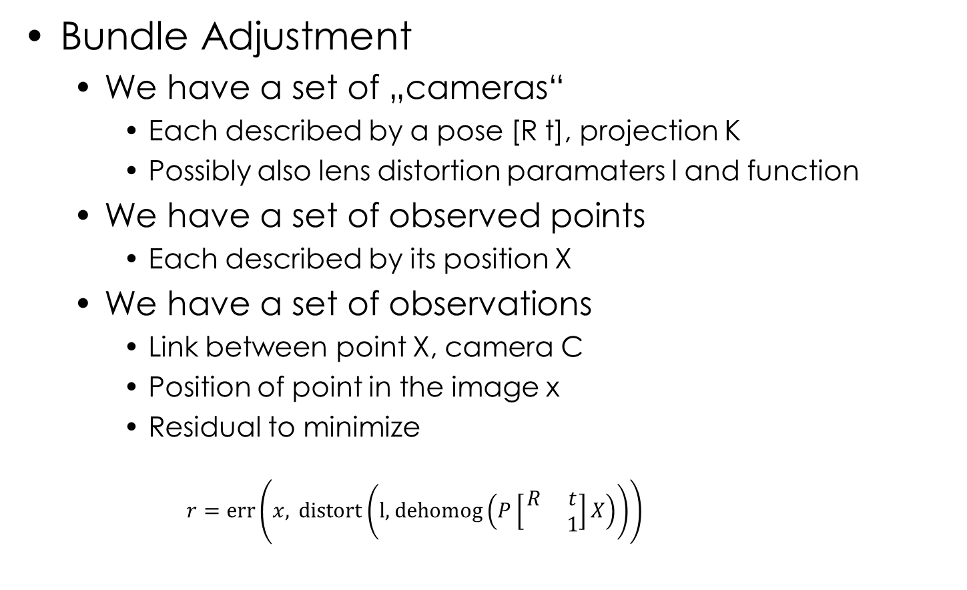
Problem Statement (II)
Bundle Adjustment
  We have a set of „cameras“
    Each described by a pose [R t], projection K
    Possibly also lens distortion paramaters l and function
  We have a set of observed points
    Each described by its position X
  We have a set of observations
    Link between point X, camera C
    Position of point in the image x
    Residual to minimize
      $$r=\text{err}\left(x, \text{distort}\left(\text{l}\text{, }\text{dehomog}\left(P\left[\begin{matrix}R & t \\ & 1\end{matrix}\right]X\right)\right)\right)$$

Slide 20
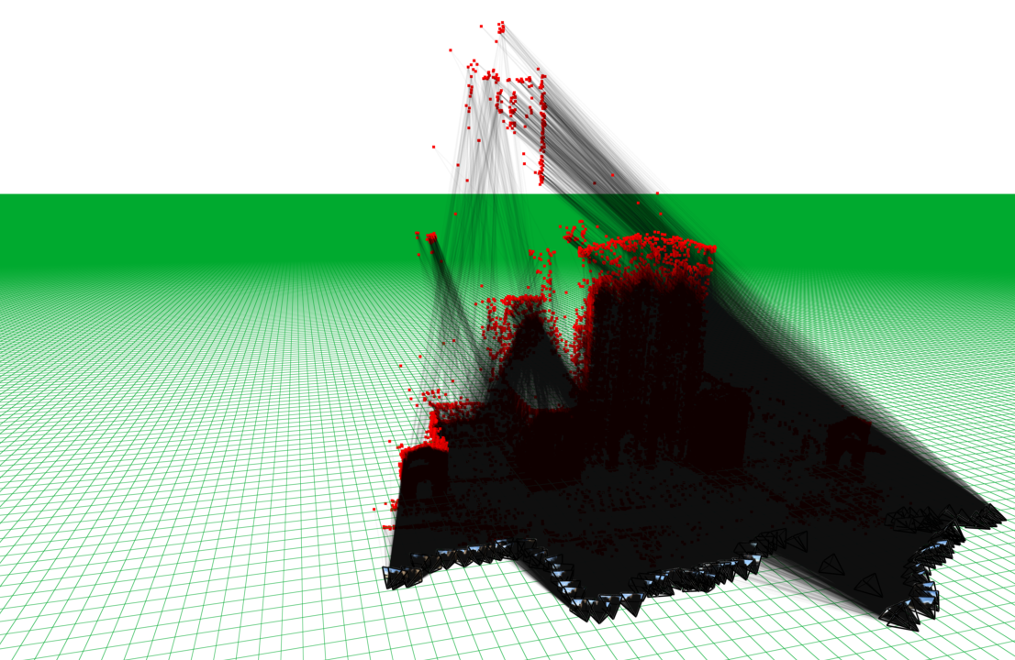
Problem Statement (II) – BA Graph Example
Guildford Cathedral
92 poses
57957 landmarks

Slide 21
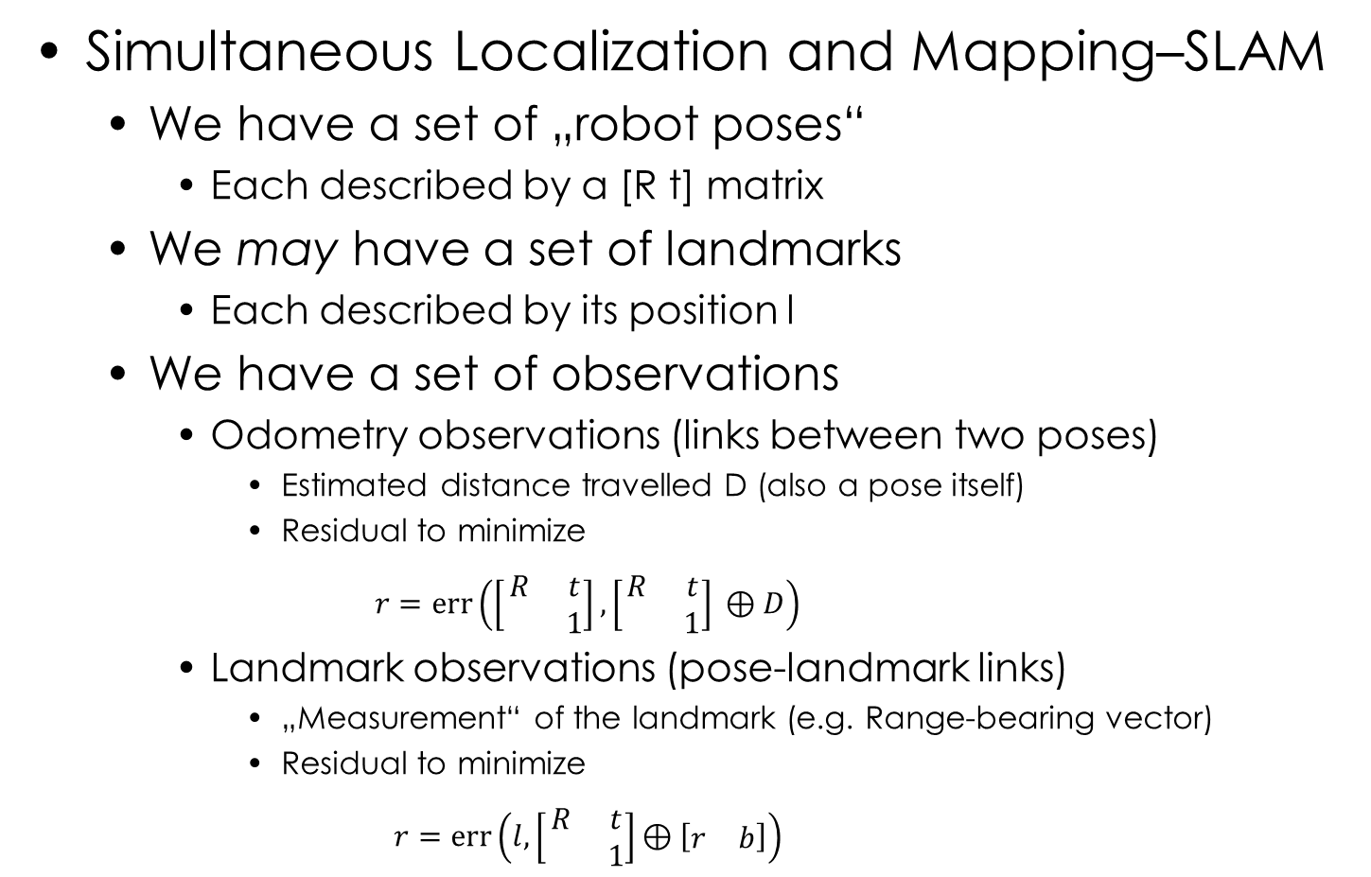
Problem Statement (II)
Simultaneous Localization and Mapping–SLAM
  We have a set of „robot poses“
    Each described by a [R t] matrix
  We may have a set of landmarks
    Each described by its position l
  We have a set of observations
    Odometry observations (links between two poses)
      Estimated distance travelled D (also a pose itself)
      Residual to minimize
      $$r=\text{err}\left(\left[\begin{matrix}R & t \\ & 1\end{matrix}\right],\left[\begin{matrix}R & t \\ & 1\end{matrix}\right] \text{⊕} D\right)$$
    Landmark observations (pose-landmark links)
      „Measurement“ of the landmark (e.g. Range-bearing vector)
      Residual to minimize
      $$r=\text{err}\left(l,\left[\begin{matrix}R & t \\ & 1\end{matrix}\right]\text{⊕} \left[\begin{matrix}r & b\end{matrix}\right]\right)$$

Slide 22
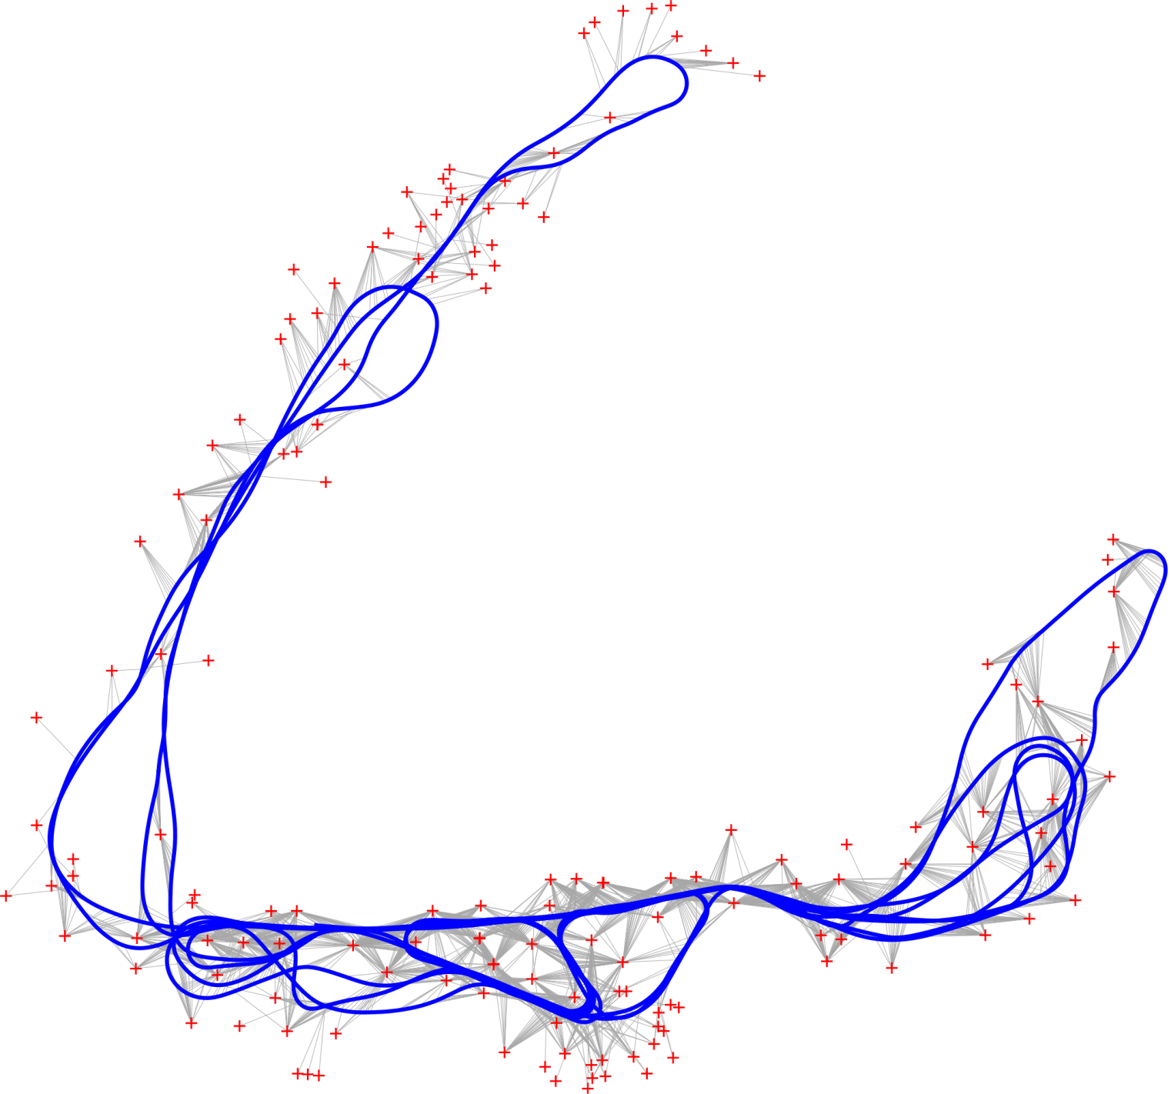
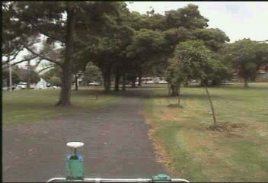
Problem Statement (II) – SLAM Graph Example
Victoria Park (Sydney)
6969 poses
151 landmarks

Slide 23
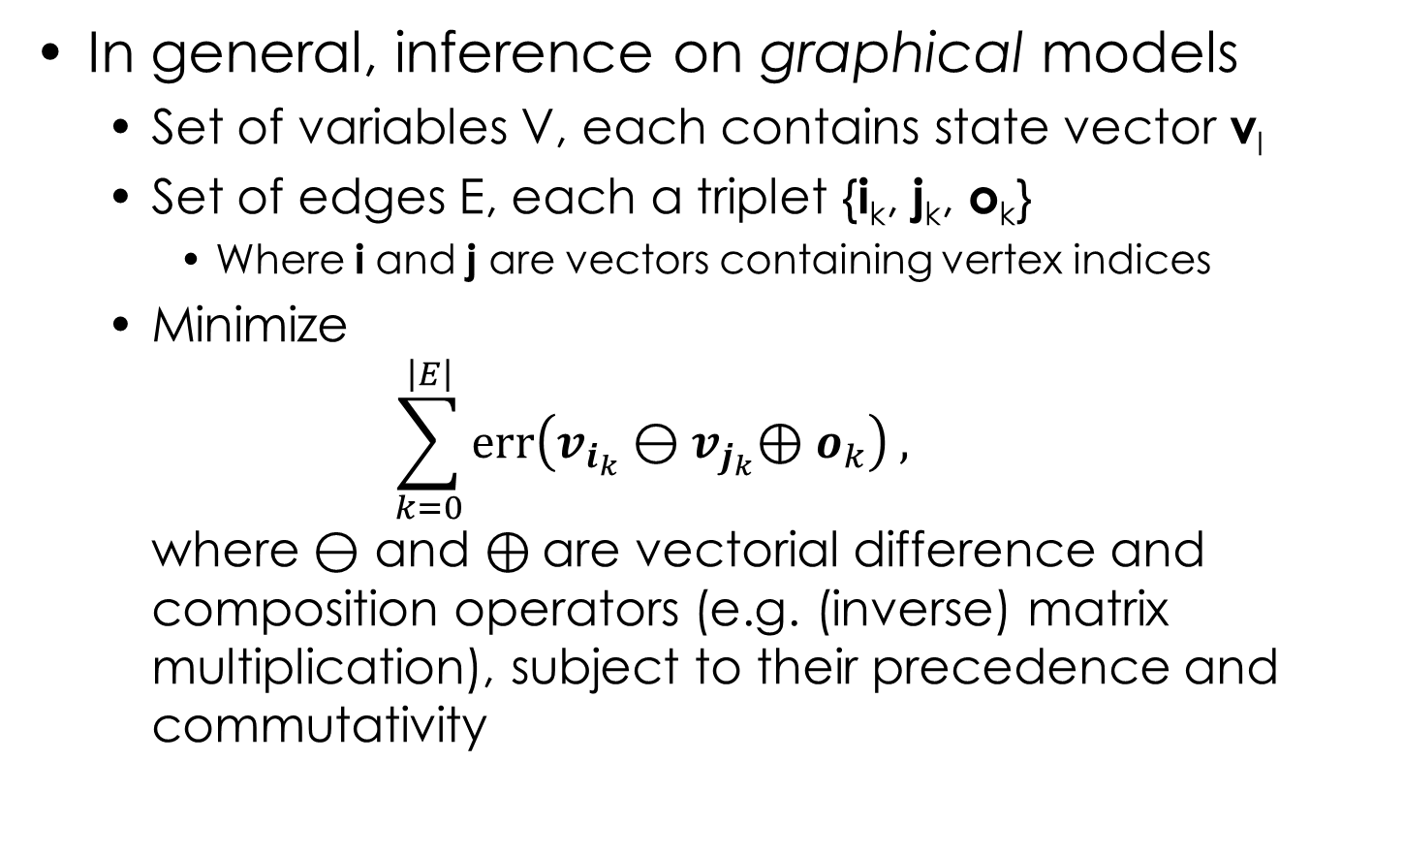
Problem Statement (II)
In general, inference on graphical models
  Set of variables V, each contains state vector v_{l}
  Set of edges E, each a triplet {i_{k}, j_{k}, o_{k}}
    Where i and j are vectors containing vertex indices
  Minimize
  $\sum_{k=0}^{\left|E\right|}{\text{err}\left(v_{i_{k}}⊖v_{j_{k}}\text{⊕} o_{k}\right) ,}$
  where $⊖$ and ⊕ are vectorial difference and composition operators (e.g. (inverse) matrix multiplication), subject to their precedence and commutativity

Slide 24
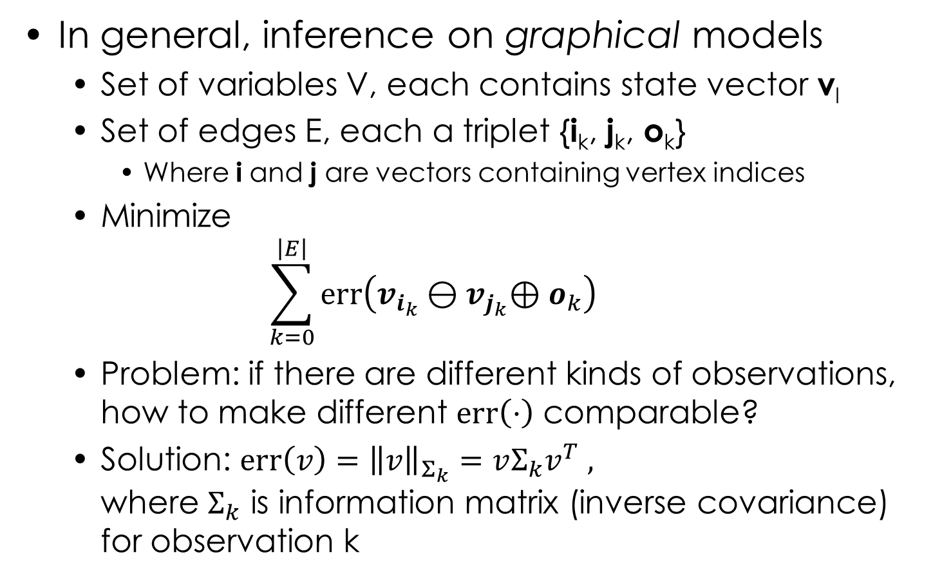
Problem Statement (II)
In general, inference on graphical models
  Set of variables V, each contains state vector v_{l}
  Set of edges E, each a triplet {i_{k}, j_{k}, o_{k}}
    Where i and j are vectors containing vertex indices
  Minimize
  $\sum_{k=0}^{\left|E\right|}{\text{err}\left(v_{i_{k}}⊖v_{j_{k}}\text{⊕} o_{k}\right)}$
  Problem: if there are different kinds of observations, how to make different $\text{err}\left(·\right)$ comparable?
  Solution: $\text{err}\left(v\right)={\left\|v\right\|}_{Σ_{k}}=vΣ_{k}v^{T} ,$
  where $Σ_{k}$ is information matrix (inverse covariance) for observation k

Slide 25
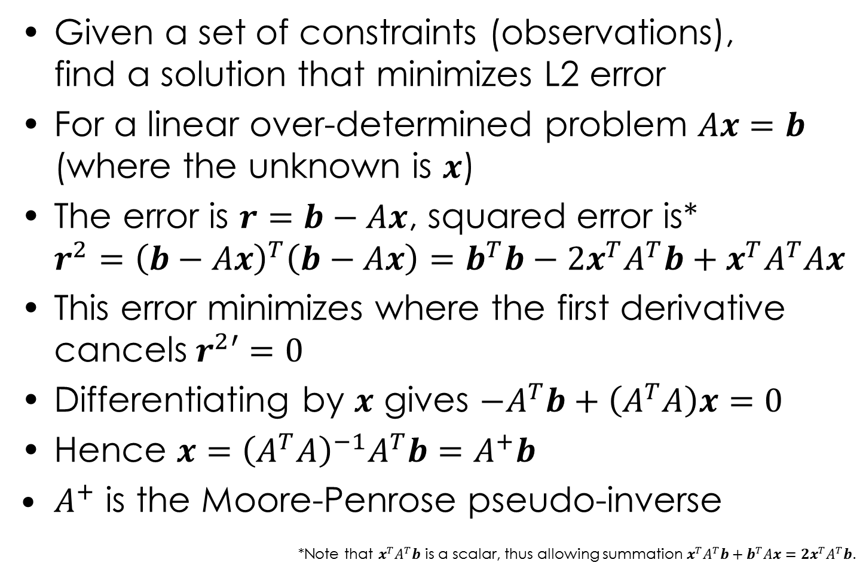
Least Squares
Given a set of constraints (observations),
find a solution that minimizes L2 error
For a linear over-determined problem $Ax=b$
(where the unknown is $x$)
The error is $r=b−Ax$, squared error is*
$r^{2}={\left(b−Ax\right)}^{T}\left(b−Ax\right)=b^{T}b−2x^{T}A^{T}b+x^{T}A^{T}Ax$
This error minimizes where the first derivative cancels$r^{2}′=0$
Differentiating by $x$ gives $−A^{T}b+\left(A^{T}A\right)x=0$
Hence $x={\left(A^{T}A\right)}^{−1}A^{T}b=A^{+}b$
$A^{+}$ is the Moore-Penrose pseudo-inverse
*Note that $x^{T}A^{T}b$ is a scalar, thus allowing summation $x^{T}A^{T}b+b^{T}Ax=2x^{T}A^{T}b$.

Slide 26
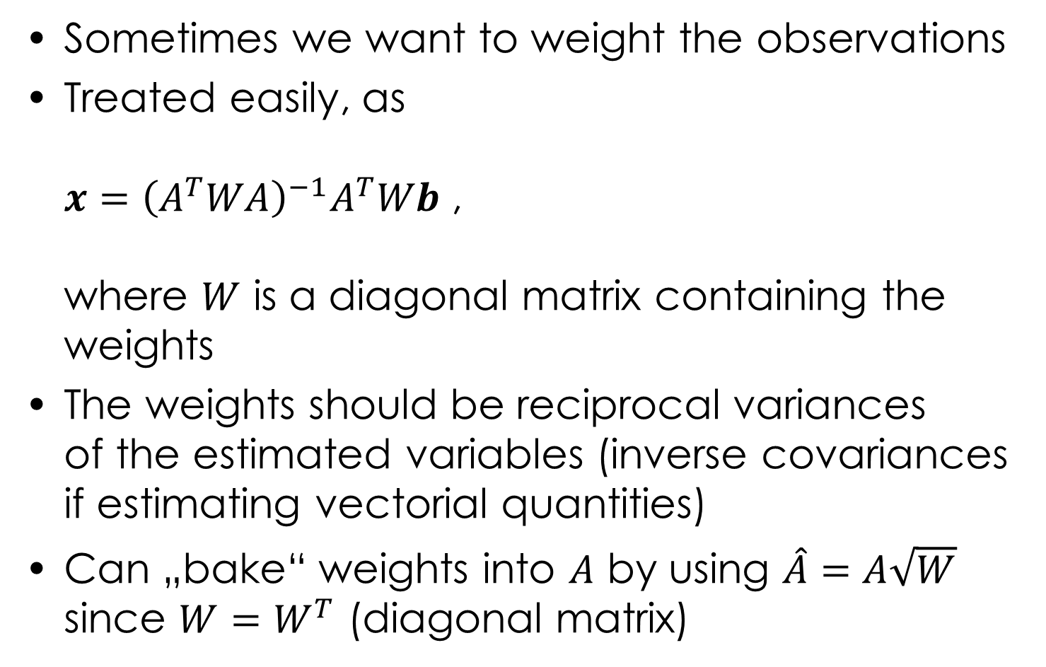
Weighted Linear Least Squares
Sometimes we want to weight the observations
Treated easily, as
$x={\left(A^{T}WA\right)}^{−1}A^{T}Wb$ ,
where $W$ is a diagonal matrix containing the weights
The weights should be reciprocal variances
of the estimated variables (inverse covariances if estimating vectorial quantities)
Can „bake“ weights into $A$ by using $\hat{A}=A\sqrt{W}$ since $W=W^{T}$ (diagonal matrix)

Slide 27
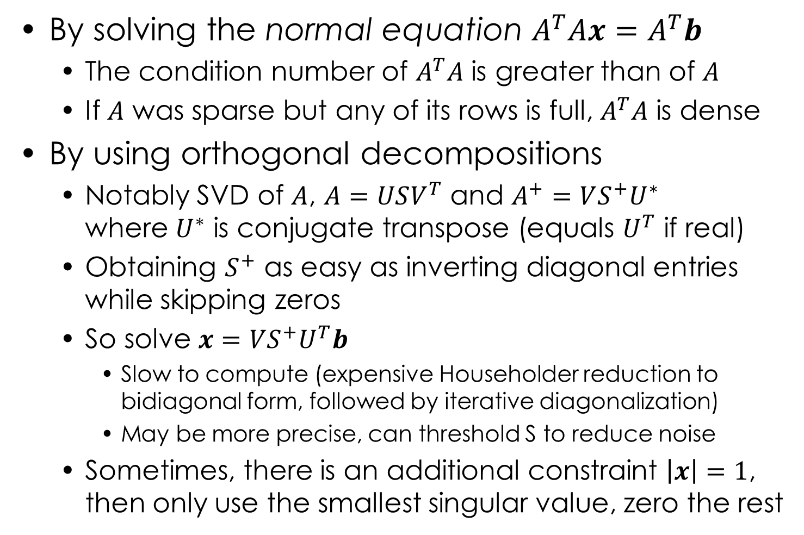
Solving Least Squares
By solving the normal equation $A^{T}Ax=A^{T}b$
  The condition number of $A^{T}A$ is greater than of $A$
  If $A$ was sparse but any of its rows is full, $A^{T}A$ is dense
By using orthogonal decompositions
  Notably SVD of $A$, $A=USV^{T}$ and $A^{+}=VS^{+}U^{∗}$
  where $U^{∗}$ is conjugate transpose (equals $U^{T}$ if real)
  Obtaining $S^{+}$ as easy as inverting diagonal entries while skipping zeros
  So solve $x=$ $VS^{+}U^{T}b$
    Slow to compute (expensive Householder reduction to bidiagonal form, followed by iterative diagonalization)
    May be more precise, can threshold S to reduce noise
  Sometimes, there is an additional constraint $\left|x\right|=1$,
  then only use the smallest singular value, zero the rest

Slide 28
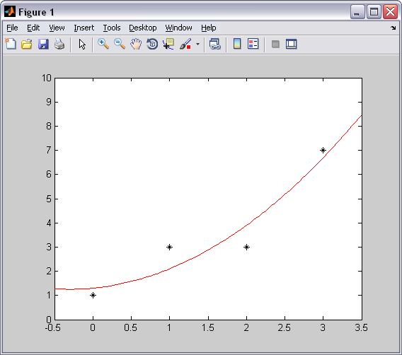
Least Squares Demo (Matlab)
O = [0 1; 1 3; 2 3; 3 7];
% observations of some 1D function
% O(:,1) are the arguments, a
% O(:,2) are the desired fit values, b
% we are trying to estimate b = p + qa + ra^2
% where x = [p q r] is our unknown
m = length(O);
A = [ones(m, 1), O(:, 1), O(:, 1).^2];
% stack the equations (1p + aq + a^2r)
x = (A' * A) \ A' * O(:,2)
% solve normal equation (backslash = solve)
xx = linspace(min(O(:, 1)) - .5, max(O(:, 1)) + .5);
yy = x(1) + x(2) * xx + x(3) * (xx.^2);
% evaluate the estimated model
plot(O(:, 1), O(:, 2), '*k') % plot a-s, b-s
hold on
plot(xx, yy, '-r') % plot the fitted curve
hold off

Slide 29
Least Squares Demo (Matlab)
O = [0 1; 1 3; 2 3; 3 7];
% observations of some 1D function
% O(:,1) are the arguments, a
% O(:,2) are the desired fit values, b
% we are trying to estimate b = p + qa + ra^2
% where x = [p q r] is our unknown
m = length(O);
A = [ones(m, 1), O(:, 1), O(:, 1).^2];
% stack the equations (1p + aq + a^2r)
[U,S,V] = svd(A); % take SVD of A
Splus = zeros(size(S')); % S' may be rectangular
n = size(A, 2); % length of the diagonal
Splus(1:n, 1:n) = diag(1 ./ diag(S))' % recip. diag.
x = V * Splus * U' * O(:,2)
% solve using SVD
xx = linspace(min(O(:, 1)) - .5, max(O(:, 1)) + .5);
yy = x(1) + x(2) * xx + x(3) * (xx.^2);
% evaluate the estimated model
plot(O(:, 1), O(:, 2), '*k') % plot a-s, b-s
hold on
plot(xx, yy, '-r') % plot the fitted curve
hold off

Slide 30
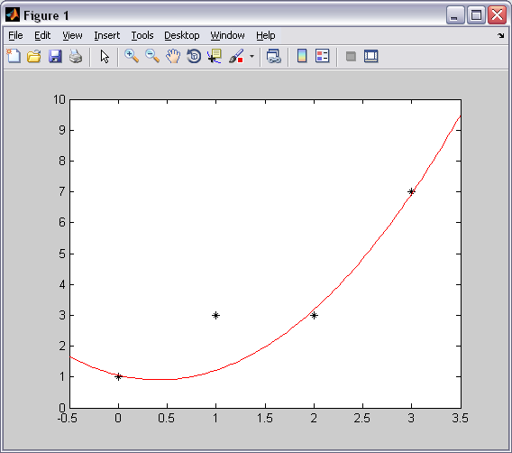
Weighted Least Squares Demo (Matlab)
O = [0 1; 1 3; 2 3; 3 7];
% observations of some 1D function
% O(:,1) are the arguments, a
% O(:,2) are the desired fit values, b
W = diag([10 1 10 10])
% weights for the observations
m = length(O);
A = [ones(m, 1), O(:, 1), O(:, 1).^2];
% stack the equations (1p + aq + a^2r)
x = (A' * W * A) \ A' * W * O(:, 2)
% solve normal equation (backslash = solve)
xx = linspace(min(O(:, 1)) - .5, max(O(:, 1)) + .5);
yy = x(1) + x(2) * xx + x(3) * (xx.^2);
% evaluate the estimated model
plot(O(:, 1), O(:, 2), '*k') % plot a-s, b-s
hold on
plot(xx, yy, '-r') % plot the fitted curve
hold off

Slide 31
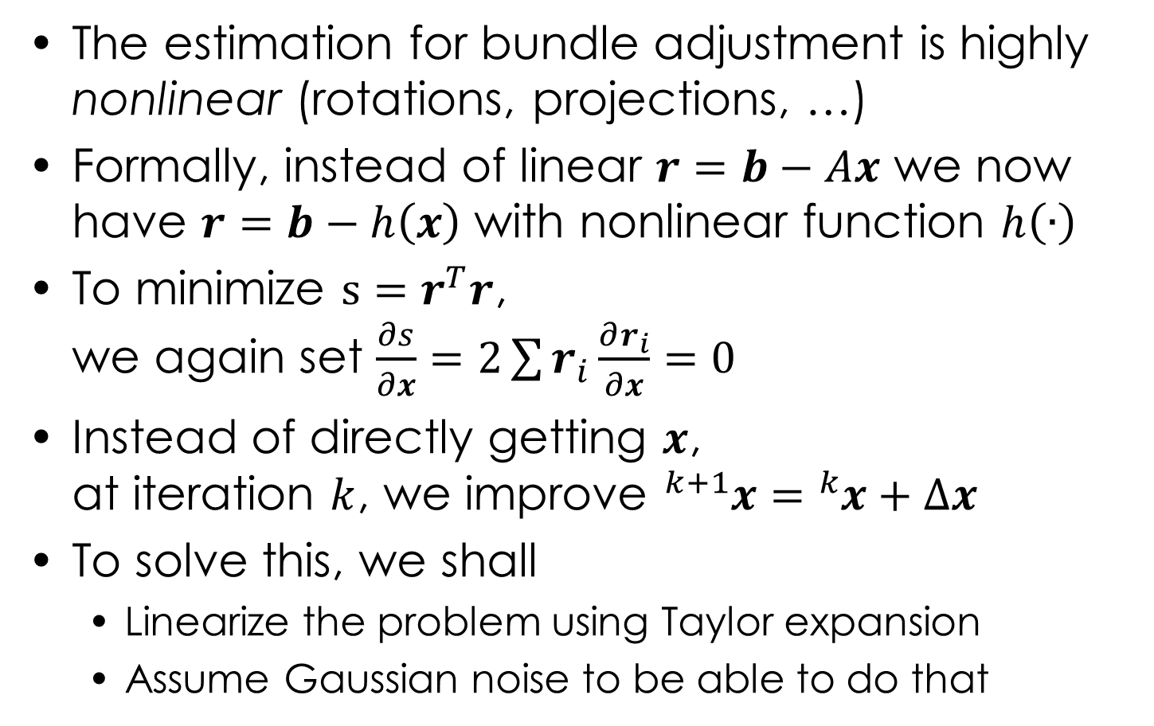
Nonlinear Least Squares
The estimation for bundle adjustment is highly nonlinear (rotations, projections, …)
Formally, instead of linear $r=b−Ax$ we now have $r=b−h\left(x\right)$ with nonlinear function $h\left(∙\right)$
To minimize $s=r^{T}r$,
we again set $\frac{∂s}{∂x}=2\sum{r_{i}\frac{∂r_{i}}{∂x}}=0$
Instead of directly getting $x$,
at iteration $k$, we improve ${}_{}^{k+1}x={}_{}^{k}x+∆x$
To solve this, we shall
  Linearize the problem using Taylor expansion
  Assume Gaussian noise to be able to do that

Slide 32
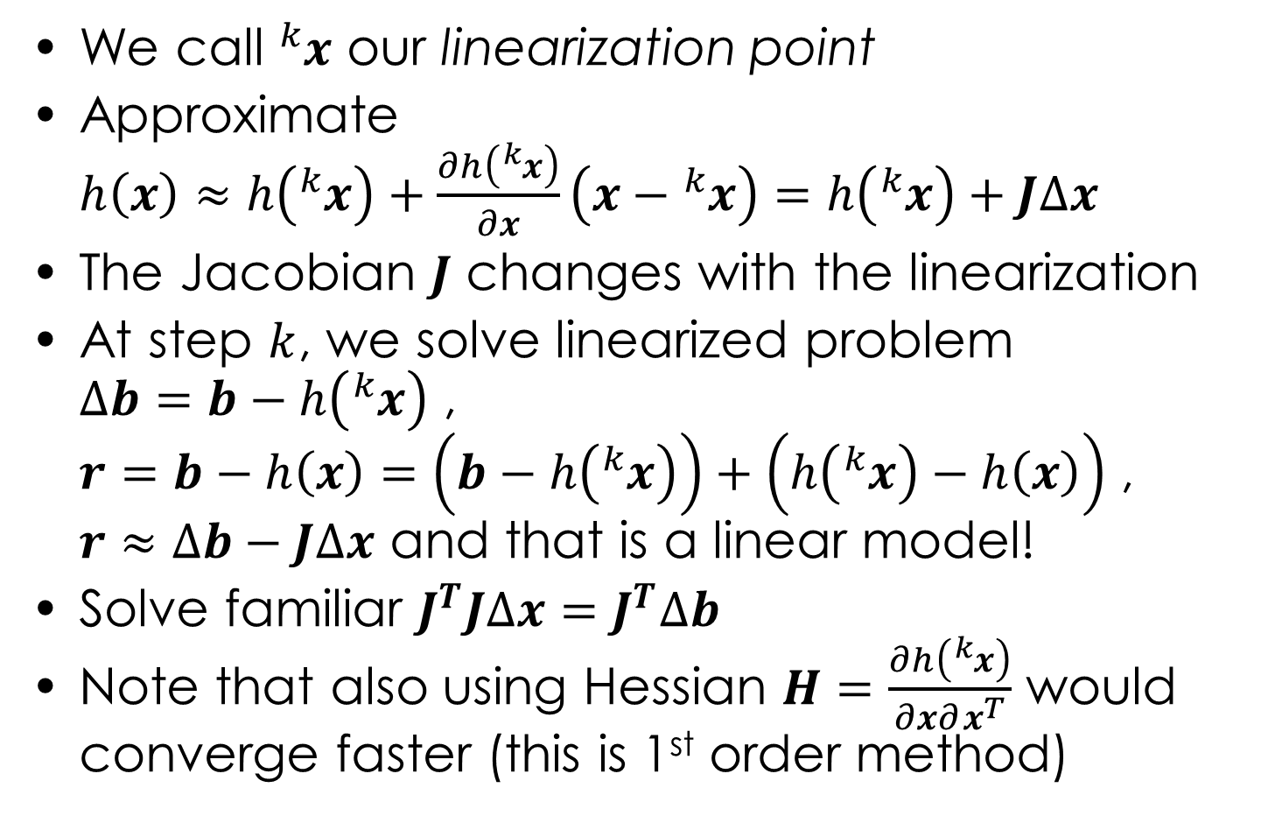
Nonlinear Least Squares
We call ${}_{}^{k}x$ our linearization point
Approximate
$h\left(x\right)≈h\left({}_{}^{k}x\right)+\frac{∂h\left({}_{}^{k}x\right)}{∂x}\left(x−{}_{}^{k}x\right)=h\left({}_{}^{k}x\right)+J∆x$
The Jacobian $J$ changes with the linearization
At step $k$, we solve linearized problem
$∆b=b−h\left({}_{}^{k}x\right)$ ,
$r=b−h\left(x\right)=\left(b−h\left({}_{}^{k}x\right)\right)+\left(h\left({}_{}^{k}x\right)−h\left(x\right)\right)$ ,
$r$ $≈∆b−J∆x$ and that is a linear model!
Solve familiar $J^{T}J∆x=J^{T}∆b$
Note that also using Hessian $H=\frac{∂h\left({}_{}^{k}x\right)}{∂x∂x^{T}}$ would converge faster (this is 1st order method)

Slide 33
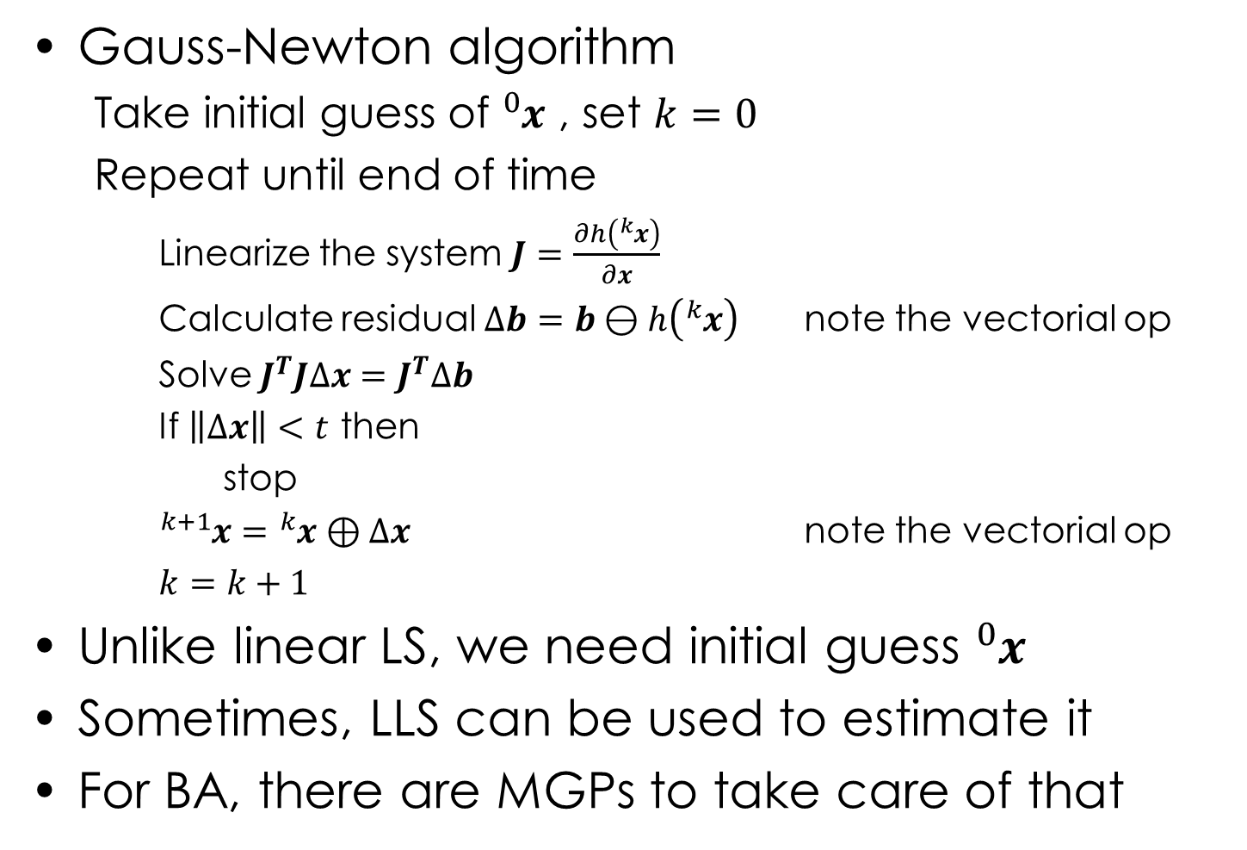
Nonlinear Least Squares
Gauss-Newton algorithm
  Take initial guess of ${}_{}^{0}x$ , set $k=0$
  Repeat until end of time
    Linearize the system $J=\frac{∂h\left({}_{}^{k}x\right)}{∂x}$
    Calculate residual $∆b=b⊖h\left({}_{}^{k}x\right)$ note the vectorial op
    Solve $J^{T}J∆x=J^{T}∆b$
    If $\left\|∆x\right\|<t$ then
      stop
    ${}_{}^{k+1}x={}_{}^{k}x⊕∆x$ note the vectorial op
    $k=k+1$
Unlike linear LS, we need initial guess ${}_{}^{0}x$
Sometimes, LLS can be used to estimate it
For BA, there are MGPs to take care of that

Slide 34
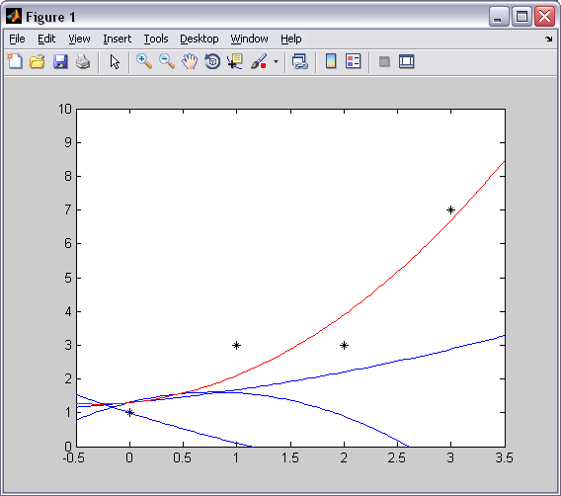
Nonlinear Least Squares Demo (Matlab)
O = [0 1; 1 3; 2 3; 3 7]; % we are trying to estimate b = p + pqa + pqra^2
% observations of some 1D function % where x = [p q r] is our unknown
% O is vector of pairs arg. a and desired fit b % h(x) = p + pqa + pqra^2, J = dh(x) / dx = [1+qa+qra^2, pa+pra^2, qa^2]
% we use this parameterization to make it nonlinear (would work with linear
x = [1 -1 -.1]'; % too but would be able to optimize in a single step, which would be boring)
% guess ⁰x (deliberately a bad guess, to take a few steps)
plot(O(:, 1), O(:, 2), '*k') % plot a-s, b-s
hold on
xx = linspace(min(O(:, 1)) - .5, max(O(:, 1)) + .5);
for i = 1:10
yy = x(1) + x(1) * x(2) * xx + x(1) * x(2) * x(3) * (xx.^2);
plot(xx, yy, '-b') % plot the initial guess
% evaluate the initial guess
J = [1 + x(2) * O(:, 1) + x(2) * x(3) * O(:, 1).^2, ...
x(1) * O(:, 1) + x(1) * x(3) * O(:, 1).^2, x(1) * x(2) * O(:, 1).^2];
% calculate the Jacobian
db = O(:,2) - x(1) - O(:,1) * x(1) * x(2) - O(:,1).^2 * x(1) * x(2) * x(3);
% calculate current error vector
dx = (J' * J) \ J' * db; norm_dx = norm(dx)
% solve
if(norm_dx < 1e-6) % see if we optimize
break
end
x = x + dx % increment
end
yy = x(1) + x(1) * x(2) * xx + x(1) * x(2) * x(3) * (xx.^2);
plot(xx, yy, '-r') % plot the final in red
hold off

Slide 35
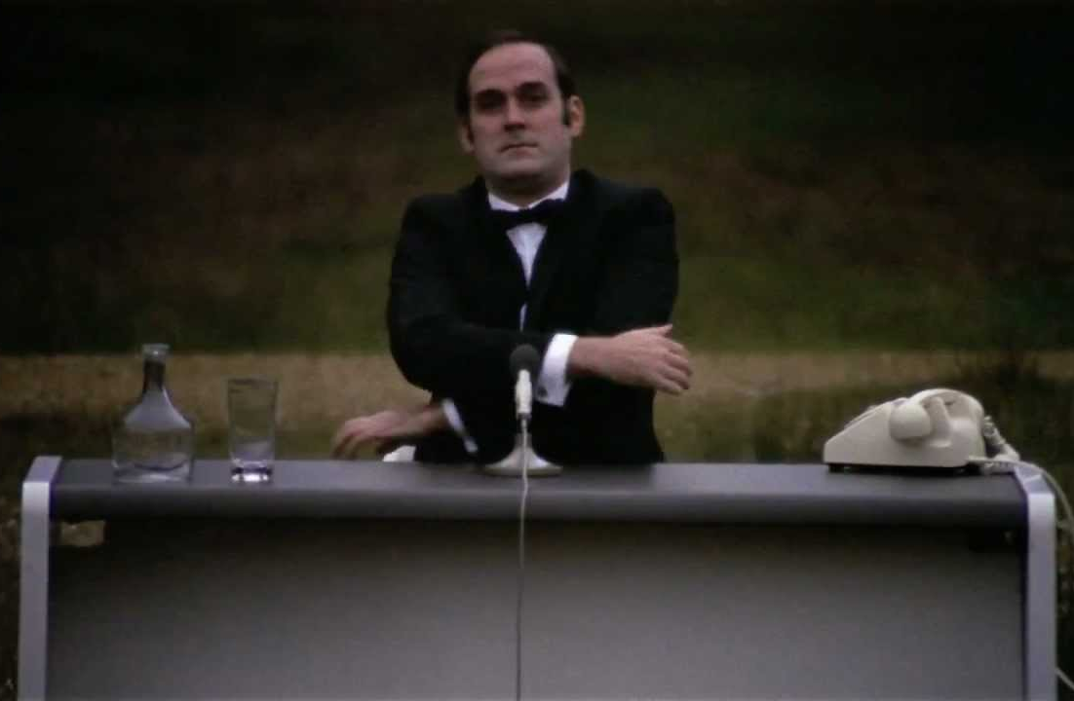
Intermezzo I
And now for something completely different …

Slide 36
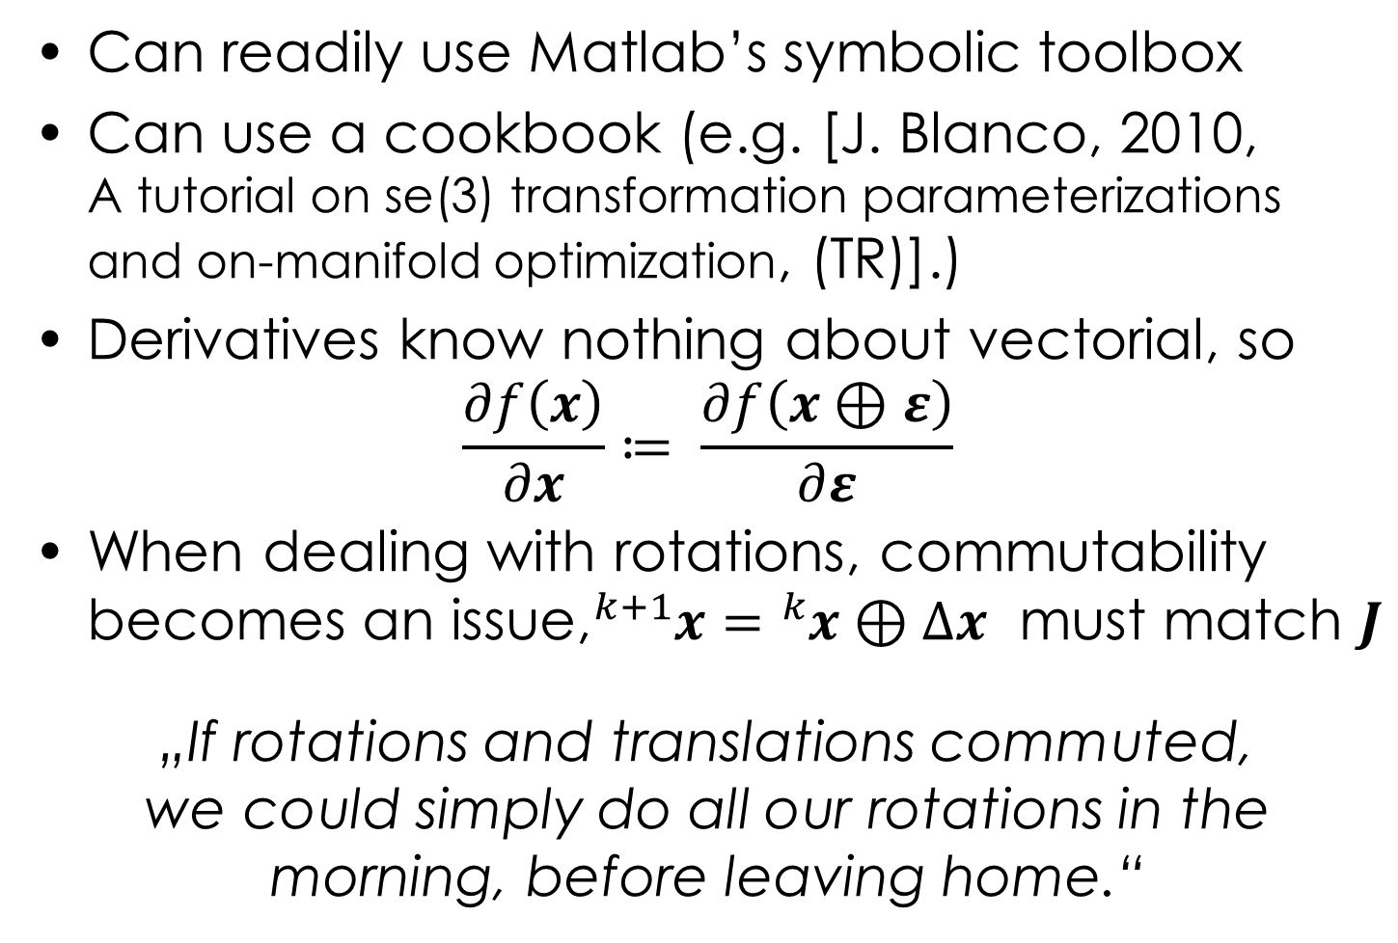
Getting Derivatives
Can readily use Matlab’s symbolic toolbox
Can use a cookbook (e.g. [J. Blanco, 2010,
A tutorial on se(3) transformation parameterizations and on-manifold optimization, (TR)].)
Derivatives know nothing about vectorial, so
$\frac{∂f\left(x\right)}{∂x}≔ \frac{∂f\left(x⊕ε\right)}{∂ε}$
When dealing with rotations, commutability becomes an issue,${}_{}^{k+1}x={}_{}^{k}x⊕∆x$ must match $J$
„If rotations and translations commuted,
we could simply do all our rotations in the morning, before leaving home.“

Slide 37
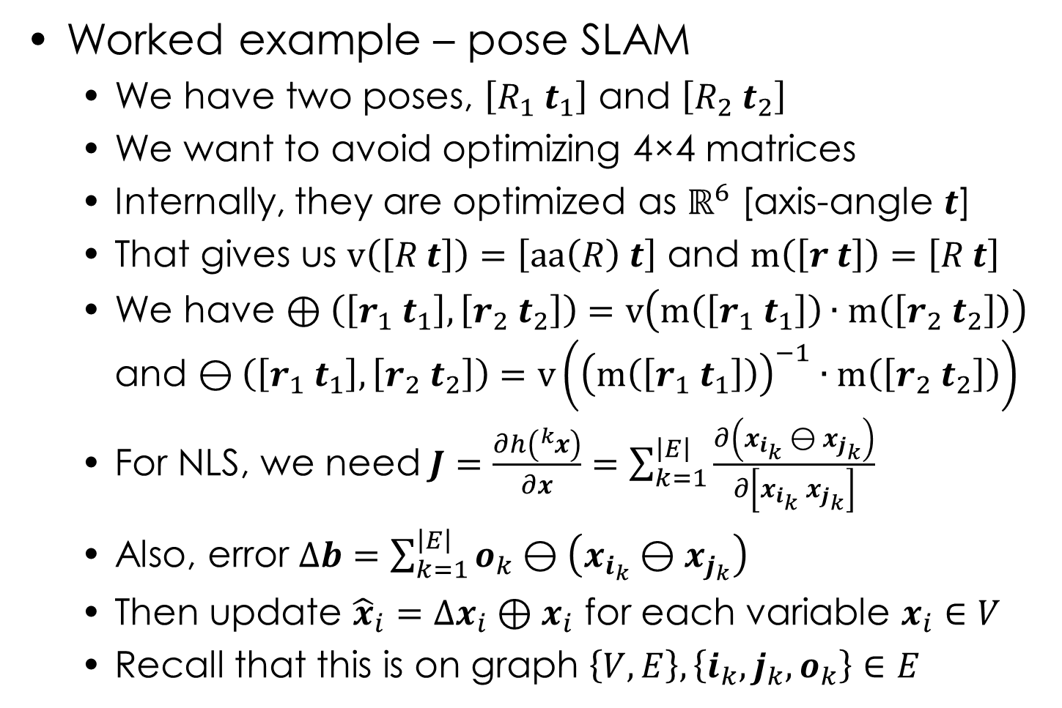
Getting Derivatives
Worked example – pose SLAM
  We have two poses, $\left[R_{1} t_{1}\right]$ and $\left[R_{2} t_{2}\right]$
  We want to avoid optimizing 4×4 matrices
  Internally, they are optimized as $ℝ^{6}$ [axis-angle $t$]
  That gives us $\text{v}\left(\left[R t\right]\right)=\left[\text{aa}\left(R\right) t\right]$ and $\text{m}\left(\left[r t\right]\right)=\left[R t\right]$
  We have $⊕\left(\left[r_{1} t_{1}\right],\left[r_{2} t_{2}\right]\right)=\text{v}\left(\text{m}\left(\left[r_{1} t_{1}\right]\right)∙\text{m}\left(\left[r_{2} t_{2}\right]\right)\right)$ and $⊖\left(\left[r_{1} t_{1}\right],\left[r_{2} t_{2}\right]\right)=\text{v}\left({\left(\text{m}\left(\left[r_{1} t_{1}\right]\right)\right)}^{−1}∙\text{m}\left(\left[r_{2} t_{2}\right]\right)\right)$
  For NLS, we need $J=\frac{∂h\left({}_{}^{k}x\right)}{∂x}=\sum_{k=1}^{\left|E\right|}{\frac{∂\left(x_{i_{k}} ⊖ x_{j_{k}}\right)}{∂\left[x_{i_{k}} x_{j_{k}}\right]}}$
  Also, error $∆b=\sum_{k=1}^{\left|E\right|}{o_{k}⊖\left(x_{i_{k}}⊖x_{j_{k}}\right)}$
  Then update ${\hat{x}}_{i}={∆x}_{i}⊕x_{i}$ for each variable $x_{i}∈V$
  Recall that this is on graph $\left\{V,E\right\}, \left\{{i_{k},j_{k},o}_{k}\right\}∈E$

Slide 38
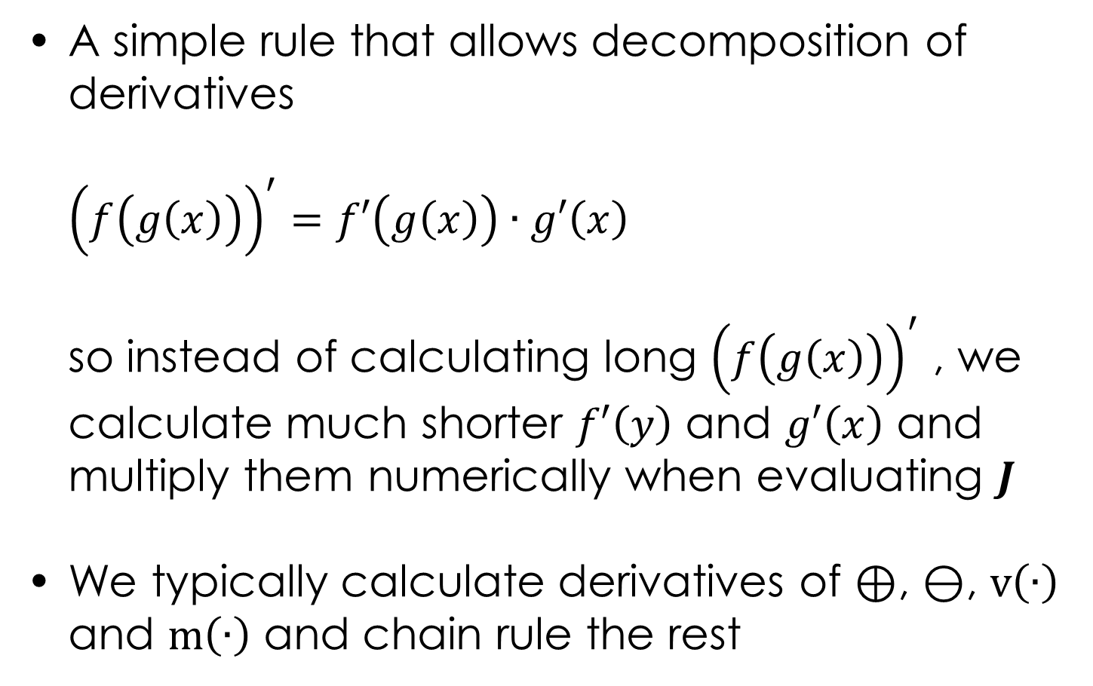
Chain rule
A simple rule that allows decomposition of derivatives
${\left(f\left(g\left(x\right)\right)\right)}^{′}=f′\left(g\left(x\right)\right)∙g′\left(x\right)$
so instead of calculating long ${\left(f\left(g\left(x\right)\right)\right)}^{′}$ , we calculate much shorter $f′\left(y\right)$ and $g′\left(x\right)$ and multiply them numerically when evaluating $J$
We typically calculate derivatives of $⊕$, $⊖$, $\text{v}\left(∙\right)$ and $\text{m}\left(∙\right)$ and chain rule the rest

Slide 39
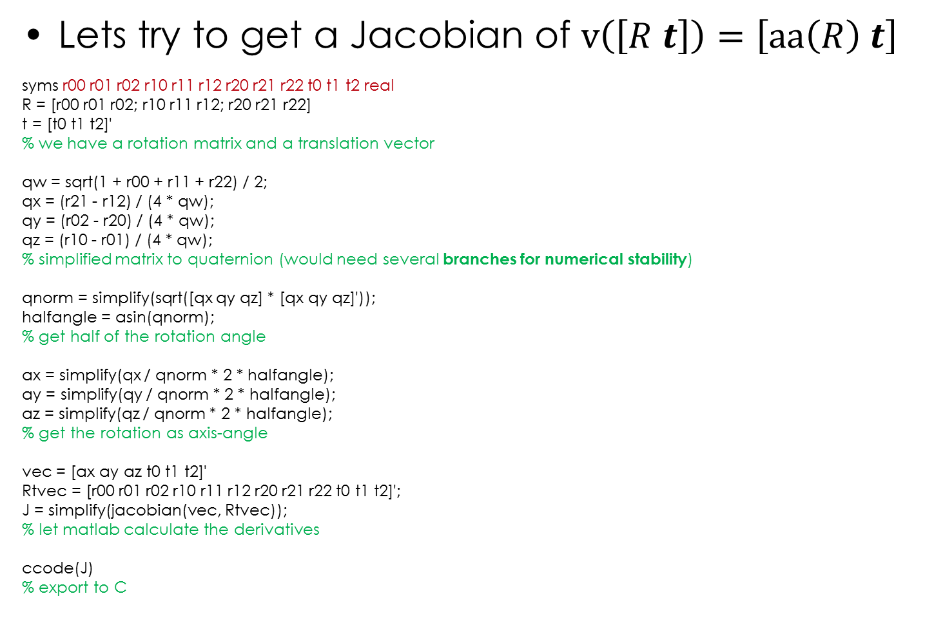
SLAM Derivatives Continued
Lets try to get a Jacobian of $\text{v}\left(\left[R t\right]\right)=\left[\text{aa}\left(R\right) t\right]$
syms r00 r01 r02 r10 r11 r12 r20 r21 r22 t0 t1 t2 real
R = [r00 r01 r02; r10 r11 r12; r20 r21 r22]
t = [t0 t1 t2]'
% we have a rotation matrix and a translation vector
qw = sqrt(1 + r00 + r11 + r22) / 2;
qx = (r21 - r12) / (4 * qw);
qy = (r02 - r20) / (4 * qw);
qz = (r10 - r01) / (4 * qw);
% simplified matrix to quaternion (would need several branches for numerical stability)
qnorm = simplify(sqrt([qx qy qz] * [qx qy qz]'));
halfangle = asin(qnorm);
% get half of the rotation angle
ax = simplify(qx / qnorm * 2 * halfangle);
ay = simplify(qy / qnorm * 2 * halfangle);
az = simplify(qz / qnorm * 2 * halfangle);
% get the rotation as axis-angle
vec = [ax ay az t0 t1 t2]'
Rtvec = [r00 r01 r02 r10 r11 r12 r20 r21 r22 t0 t1 t2]';
J = simplify(jacobian(vec, Rtvec));
% let matlab calculate the derivatives
ccode(J)
% export to C

Slide 40
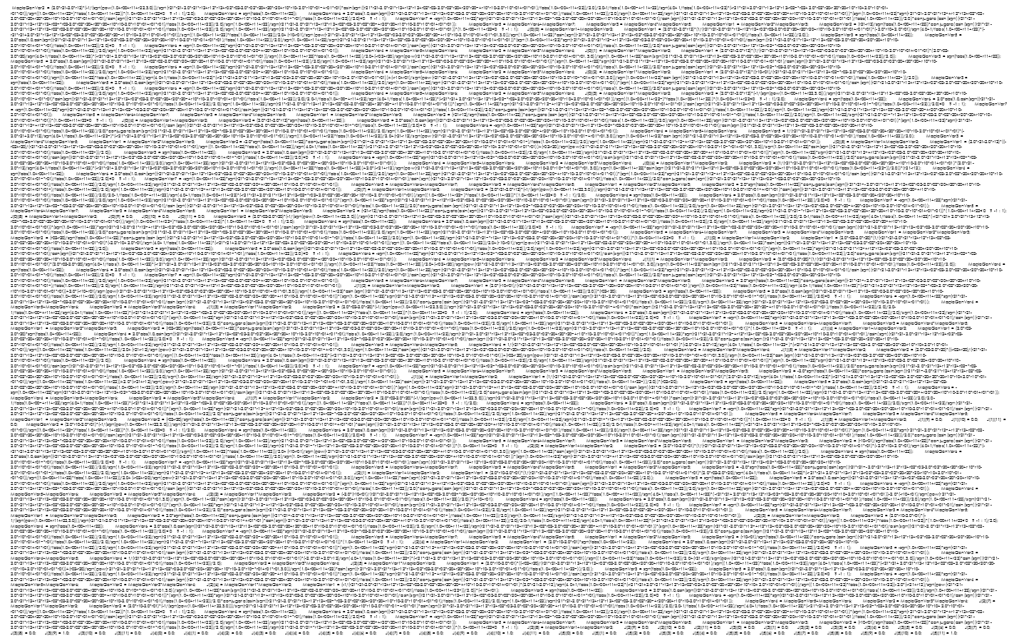
The output of ccode() I
55 kB

Slide 41
SLAM Derivatives Continued
Some more tricks
syms qnorm_ qx_ qy_ qz_ qw_ ax_ ay_ az_ real
J = subs(J, ax, ax_)
J = subs(J, ay, ay_)
J = subs(J, az, az_)
J = subs(J, qx, qx_)
J = subs(J, qy, qy_)
J = subs(J, qz, qz_)
J = subs(J, qw, qw_)
J = subs(J, qnorm, qnorm_)
% try substituting common subexpressions to tame the beast (don’t simplify J in the previous slide!)
ccode(J)
% export to C
Still generates 34 kB of C code
Gotcha – simple() and simplify() are different
Lesson learned – don’t use [R t], use Quaternions instead!

Slide 42
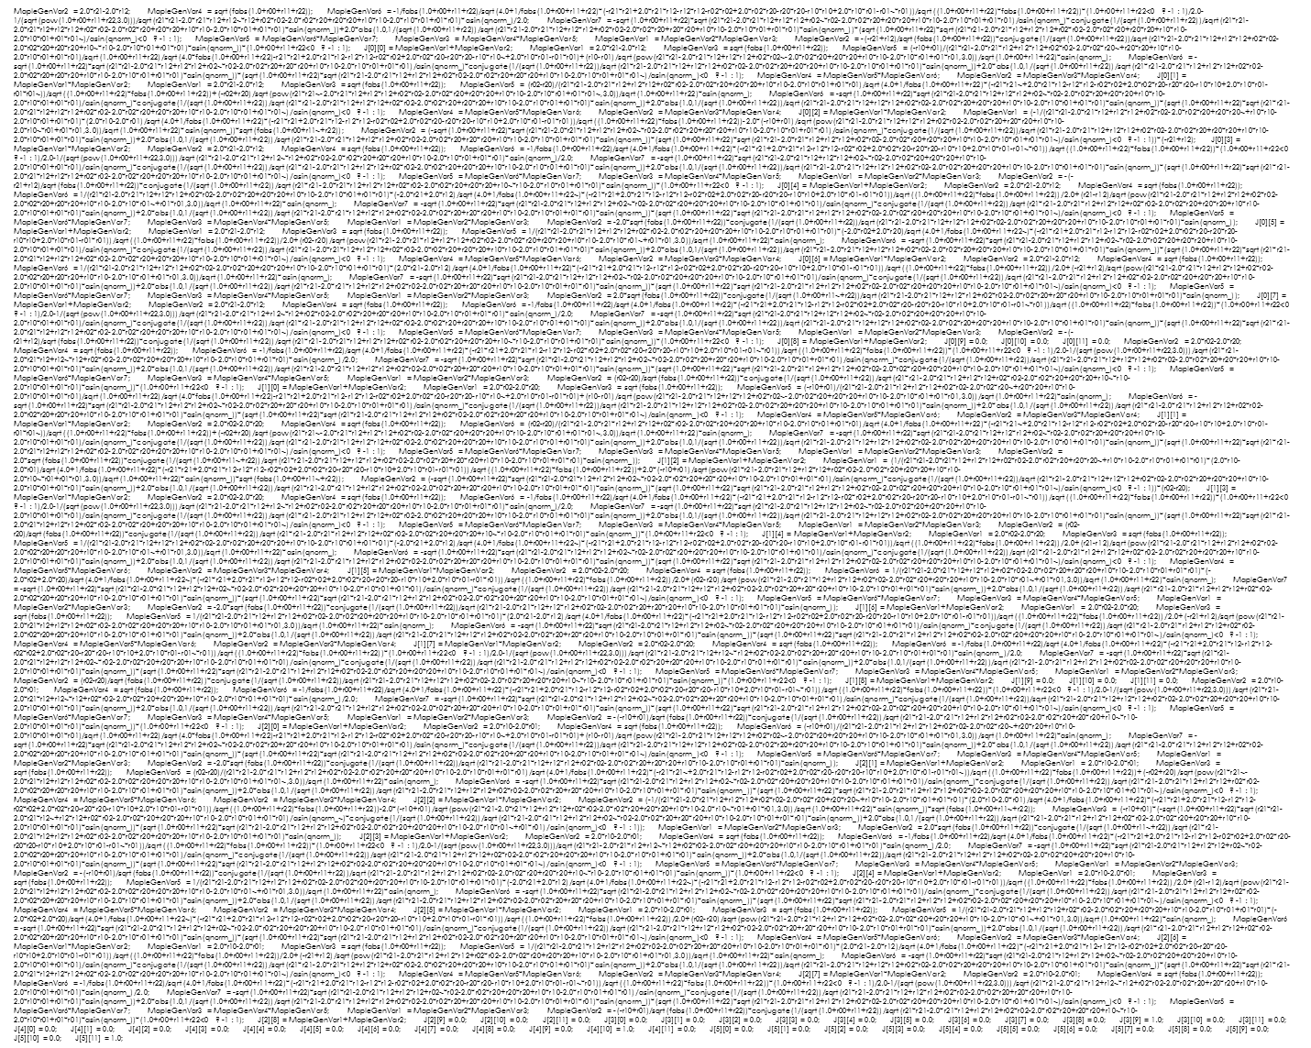
The output of ccode() II
34 kB

Slide 43

SLAM Derivatives Continued
Better yet
quat_t = [qw qx qy qz t0 t1 t2]
J0 = jacobian(quat_t, Rtvec);
%
syms ax_ ay_ az_ qx_ qy_ qz_ qw_ real
%qnorm = (sqrt([qx qy qz] * [qx qy qz]')); % MATLAB trolls you if U no careful …
qnorm = (sqrt(qx^2 + qy^2 + qz^2));
halfangle_ = asin(qnorm_);
ax_ = (qx_ / qnorm_ * 2 * halfangle_);
ay_ = (qy_ / qnorm_ * 2 * halfangle_);
az_ = (qz_ / qnorm_ * 2 * halfangle_);
vec_ = [ax_ ay_ az_ t0 t1 t2]'
quat_t_ = [qw_ qx_ qy_ qz_ t0 t1 t2]
J1 = jacobian(vec_, quat_t_);
% calculate the jacobians separately (note how J1 is on separate variables)
% chain rule as:
% f( g(R))' = f'( g(R)) * g'(R)
% aa(quat(R))' = aa'(quat(R)) * quat'(R)
% J = J1 * J0
J1 = subs(J1, qx_, qx); J1 = subs(J1, qy_, qy); J1 = subs(J1, qz_, qz); J1 = subs(J1, qw_, qw)
% substitute the quaternion to J1 (in practice, we would substitute *values* rather than *formulas*)
error = simplify(J - J1 * J0) % verify, this prints a matrix of zeros
Generates 1.94 and 2.29 kB of C for J0 and J1

Slide 44
The output of ccode() III
T[0][0] = -(r21-r12)/sqrt(pow(1.0+r00+r11+r22,3.0))/4.0; T[0][1] = 0.0; T[0][2] = 0.0; T[0][3] = 0.0; T[0][4] = -(r21-r12)/sqrt(pow(1.0+r00+r11+r22,3.0))/4.0; T[0][5] = -1/(sqrt(1.0+r00+r11+r22))/2.0; T[0][6] = 0.0; T[0][7] = 1/(sqrt(1.0+r00+r11+r22))/2.0; T[0][8] = -(r21-r12)/sqrt(pow(1.0+r00+r11+r22,3.0))/4.0; T[0][9] = 0.0; T[0][10] = 0.0; T[0][11] = 0.0; T[1][0] = -(r02-r20)/sqrt(pow(1.0+r00+r11+r22,3.0))/4.0; T[1][1] = 0.0; T[1][2] = 1/(sqrt(1.0+r00+r11+r22))/2.0; T[1][3] = 0.0; T[1][4] = -(r02-r20)/sqrt(pow(1.0+r00+r11+r22,3.0))/4.0; T[1][5] = 0.0; T[1][6] = -1/(sqrt(1.0+r00+r11+r22))/2.0; T[1][7] = 0.0; T[1][8] = -(r02-r20)/sqrt(pow(1.0+r00+r11+r22,3.0))/4.0; T[1][9] = 0.0; T[1][10] = 0.0; T[1][11] = 0.0; T[2][0] = -(r10-r01)/sqrt(pow(1.0+r00+r11+r22,3.0))/4.0; T[2][1] = -1/(sqrt(1.0+r00+r11+r22))/2.0; T[2][2] = 0.0; T[2][3] = 1/(sqrt(1.0+r00+r11+r22))/2.0; T[2][4] = -(r10-r01)/sqrt(pow(1.0+r00+r11+r22,3.0))/4.0; T[2][5] = 0.0; T[2][6] = 0.0; T[2][7] = 0.0; T[2][8] = -(r10-r01)/sqrt(pow(1.0+r00+r11+r22,3.0))/4.0; T[2][9] = 0.0; T[2][10] = 0.0; T[2][11] = 0.0; T[3][0] = 0.0; T[3][1] = 0.0; T[3][2] = 0.0; T[3][3] = 0.0; T[3][4] = 0.0; T[3][5] = 0.0; T[3][6] = 0.0; T[3][7] = 0.0; T[3][8] = 0.0; T[3][9] = 1.0; T[3][10] = 0.0; T[3][11] = 0.0; T[4][0] = 0.0; T[4][1] = 0.0; T[4][2] = 0.0; T[4][3] = 0.0; T[4][4] = 0.0; T[4][5] = 0.0; T[4][6] = 0.0; T[4][7] = 0.0; T[4][8] = 0.0; T[4][9] = 0.0; T[4][10] = 1.0; T[4][11] = 0.0; T[5][0] = 0.0; T[5][1] = 0.0; T[5][2] = 0.0; T[5][3] = 0.0; T[5][4] = 0.0; T[5][5] = 0.0; T[5][6] = 0.0; T[5][7] = 0.0; T[5][8] = 0.0; T[5][9] = 0.0; T[5][10] = 0.0; T[5][11] = 1.0;
T[0][0] = 2.0/sqrt(qx_*qx_+qy_*qy_+qz_*qz_)*asin(sqrt(qx_*qx_+qy_*qy_+qz_*qz_))-2.0*qx_*qx_/sqrt(pow(qx_*qx_+qy_*qy_+qz_*qz_,3.0))*asin(sqrt(qx_*qx_+qy_*qy_+qz_*qz_))+2.0*qx_*qx_/(qx_*qx_+qy_*qy_+qz_*qz_)/sqrt(1.0-qx_*qx_-qy_*qy_-qz_~*qz_); T[0][1] = -2.0*qx_/sqrt(pow(qx_*qx_+qy_*qy_+qz_*qz_,3.0))*asin(sqrt(qx_*qx_~+qy_*qy_+qz_*qz_))*qy_+2.0*qx_/(qx_*qx_+qy_*qy_+qz_*qz_)*qy_/sqrt(1.0-qx_*qx_~-qy_*qy_-qz_*qz_); T[0][2] = -2.0*qx_/sqrt(pow(qx_*qx_+qy_*qy_+qz_*qz_,3.0))*asin(sqrt(qx_*qx_~+qy_*qy_+qz_*qz_))*qz_+2.0*qx_/(qx_*qx_+qy_*qy_+qz_*qz_)*qz_/sqrt(1.0-qx_*qx_~-qy_*qy_-qz_*qz_); T[0][3] = 0.0; T[0][4] = 0.0; T[0][5] = 0.0; T[1][0] = -2.0*qx_/sqrt(pow(qx_*qx_+qy_*qy_+qz_*qz_,3.0))*asin(sqrt(qx_*qx_~+qy_*qy_+qz_*qz_))*qy_+2.0*qx_/(qx_*qx_+qy_*qy_+qz_*qz_)*qy_/sqrt(1.0-qx_*qx_~-qy_*qy_-qz_*qz_); T[1][1] = 2.0/sqrt(qx_*qx_+qy_*qy_+qz_*qz_)*asin(sqrt(qx_*qx_+qy_*qy_+qz_*qz_))-2.0*qy_*qy_/sqrt(pow(qx_*qx_+qy_*qy_+qz_*qz_,3.0))*asin(sqrt(qx_*qx_+qy_*qy_+qz_*qz_))+2.0*qy_*qy_/(qx_*qx_+qy_*qy_+qz_*qz_)/sqrt(1.0-qx_*qx_-qy_*qy_-qz_~*qz_); T[1][2] = -2.0*qy_/sqrt(pow(qx_*qx_+qy_*qy_+qz_*qz_,3.0))*asin(sqrt(qx_*qx_~+qy_*qy_+qz_*qz_))*qz_+2.0*qy_/(qx_*qx_+qy_*qy_+qz_*qz_)*qz_/sqrt(1.0-qx_*qx_~-qy_*qy_-qz_*qz_); T[1][3] = 0.0; T[1][4] = 0.0; T[1][5] = 0.0; T[2][0] = -2.0*qx_/sqrt(pow(qx_*qx_+qy_*qy_+qz_*qz_,3.0))*asin(sqrt(qx_*qx_~+qy_*qy_+qz_*qz_))*qz_+2.0*qx_/(qx_*qx_+qy_*qy_+qz_*qz_)*qz_/sqrt(1.0-qx_*qx_~-qy_*qy_-qz_*qz_); T[2][1] = -2.0*qy_/sqrt(pow(qx_*qx_+qy_*qy_+qz_*qz_,3.0))*asin(sqrt(qx_*qx_~+qy_*qy_+qz_*qz_))*qz_+2.0*qy_/(qx_*qx_+qy_*qy_+qz_*qz_)*qz_/sqrt(1.0-qx_*qx_~-qy_*qy_-qz_*qz_); T[2][2] = 2.0/sqrt(qx_*qx_+qy_*qy_+qz_*qz_)*asin(sqrt(qx_*qx_+qy_*qy_+qz_*qz_))-2.0*qz_*qz_/sqrt(pow(qx_*qx_+qy_*qy_+qz_*qz_,3.0))*asin(sqrt(qx_*qx_+qy_*qy_+qz_*qz_))+2.0*qz_*qz_/(qx_*qx_+qy_*qy_+qz_*qz_)/sqrt(1.0-qx_*qx_-qy_*qy_-qz_~*qz_); T[2][3] = 0.0; T[2][4] = 0.0; T[2][5] = 0.0; T[3][0] = 0.0; T[3][1] = 0.0; T[3][2] = 0.0; T[3][3] = 1.0; T[3][4] = 0.0; T[3][5] = 0.0; T[4][0] = 0.0; T[4][1] = 0.0; T[4][2] = 0.0; T[4][3] = 0.0; T[4][4] = 1.0; T[4][5] = 0.0; T[5][0] = 0.0; T[5][1] = 0.0; T[5][2] = 0.0; T[5][3] = 0.0; T[5][4] = 0.0; T[5][5] = 1.0;
4 kB

Slide 45
Matlab - Eliminating Common Subexpressions
syms temp0 temp1 temp2 temp3 real
subexpr(J0, 'temp0')
>> temp0 =
>> 1+r00+r11+r22
>> J0 =
>> [ -1/4*(r21-r12)/temp0^(3/2), 0, …
subexpr(ans, 'temp1')
subexpr(ans, 'temp2')
…
J0_ = ans;
ccode(temp0)
ccode(temp1)
ccode(temp2)
ccode(J0_)

Slide 46
The output of ccode() IV
T.setZero(); temp5 = 1.0+r00+r11+r22; temp6 = sqrt(temp5); temp7 = pow(temp5, 3.0/2);
T[0][0] = -(r21-r12)/temp7/4.0; T[0][4] = -(r21-r12)/temp7/4.0; T[0][5] = -0.5/temp6;
T[0][7] = 0.5/temp6; T[0][8] = -(r21-r12)/temp7/4.0; T[1][0] = -(r02-r20)/temp7/4.0;
T[1][2] = 0.5/temp6; T[1][4] = -(r02-r20)/temp7/4.0; T[1][6] = -0.5/temp6;
T[1][8] = -(r02-r20)/temp7/4.0; T[2][0] = -(r10-r01)/temp7/4.0; T[2][1] = -0.5/temp6;
T[2][3] = 0.5/temp6; T[2][4] = -(r10-r01)/temp7/4.0; T[2][8] = -(r10-r01)/temp7/4.0;
T[3][9] = 1.0; T[4][10] = 1.0; T[5][11] = 1.0;
T.setZero(); temp0 = qx_*qx_+qy_*qy_+qz_*qz; temp1 = sqrt(temp0);
temp2 = asin(temp1); temp3 = sqrt(1.0-temp0); temp4 = sqrt(pow(temp0,3.0))*temp2;
T[0][0] = 2.0/temp1*temp2-2.0*qx_*qx_/temp4+2.0*qx_*qx_/(temp0)/temp3;
T[0][1] = -2.0*qx_/temp4*qy_+2.0*qx_/(temp0)*qy_/temp3;
T[0][2] = -2.0*qx_/temp4*qz_+2.0*qx_/(temp0)*qz_/temp3;
T[1][0] = -2.0*qx_/temp4*qy_+2.0*qx_/(temp0)*qy_/temp3;
T[1][1] = 2.0/temp1*temp2-2.0*qy_*qy_/temp4+2.0*qy_*qy_/(temp0)/temp3;
T[1][2] = -2.0*qy_/temp4*qz_+2.0*qy_/(temp0)*qz_/temp3;
T[2][0] = -2.0*qx_/temp4*qz_+2.0*qx_/(temp0)*qz_/temp3;
T[2][1] = -2.0*qy_/temp4*qz_+2.0*qy_/(temp0)*qz_/temp3;
T[2][2] = 2.0/temp1*temp2-2.0*qz_*qz_/temp4+2.0*qz_*qz_/(temp0)/temp3;
T[3][3] = 1.0; T[4][4] = 1.0; T[5][5] = 1.0;
1 kB

Slide 47
Numerical Differentiation
Much easier for fast prototyping
Typically not horribly imprecise but can be slow
Vector6d x1, x2; // the two variables
Vector6d expectation = x1 ⊖ x2; // the function we’re differentiating
Matrix6d J1; // derivative w.r.t. x1
for(int i = 0; i < 6; ++ i) {
Vector6d eps;
eps.setZero(); eps(i) = 1e-9;
Vector6d shift1 = eps ⊕ x1; // apply infinitesimal shift (ordering!)
Vector6d value = shift1 ⊖ x2; // see how that changes the output
J1.col(i) = (value - expectation) * 1e+9; // note cwise op
}
// do the same for x2

Slide 48
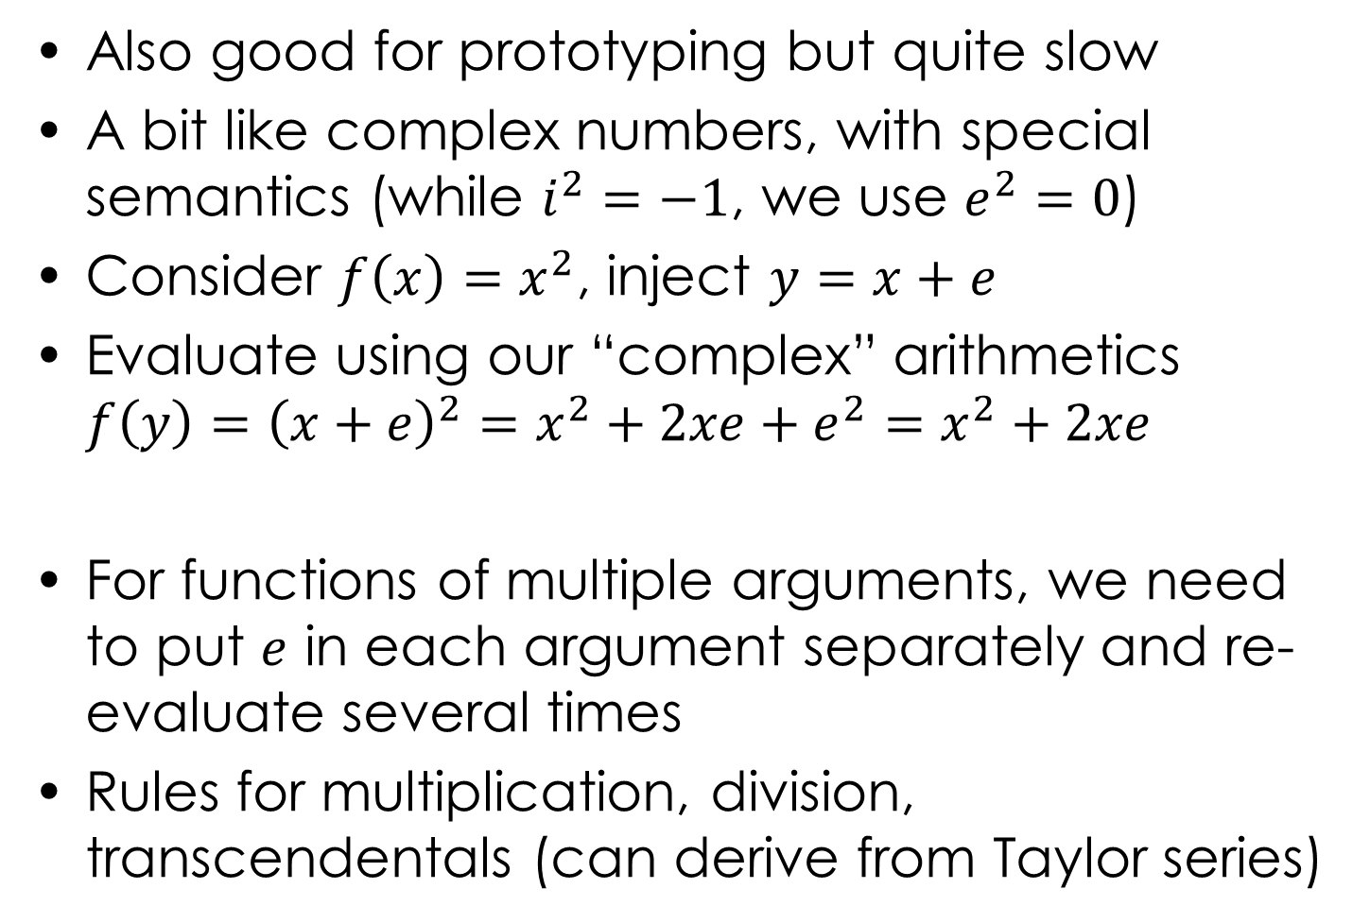
Dual Numbers
Also good for prototyping but quite slow
A bit like complex numbers, with special semantics (while $i^{2}=−1$, we use $e^{2}=0$)
Consider $f\left(x\right)=x^{2}$, inject $y=x+e$
Evaluate using our “complex” arithmetics
$f\left(y\right)={\left(x+e\right)}^{2}=x^{2}+2xe+e^{2}=x^{2}+2xe$
For functions of multiple arguments, we need to put $e$ in each argument separately and re-evaluate several times
Rules for multiplication, division, transcendentals (can derive from Taylor series)
value
derivative

Slide 49
  Lie Group Basics
Groups on differentiable manifolds
Lie group SE(3) and associated algebra 𝔰𝔢(3)
SE(3) maps to Euclidean space 𝔼³ ([R t] are in it)
𝔰𝔢(3) is the tangent space of real
skew-symmetric 4×4 matrices
Exponential map goes from 𝔰𝔢(3) to SE(3)
Logarithmic map goes from SE(3) to 𝔰𝔢(3)
Vectorial operator* [x]_{v} packs skew-sym to vec
Cross operator [x]× goes back to skew-sym
Lie bracket [x, y] = xy – yx (where x, y ∈ 𝔰𝔢(3))
*several different notations exist

Slide 50
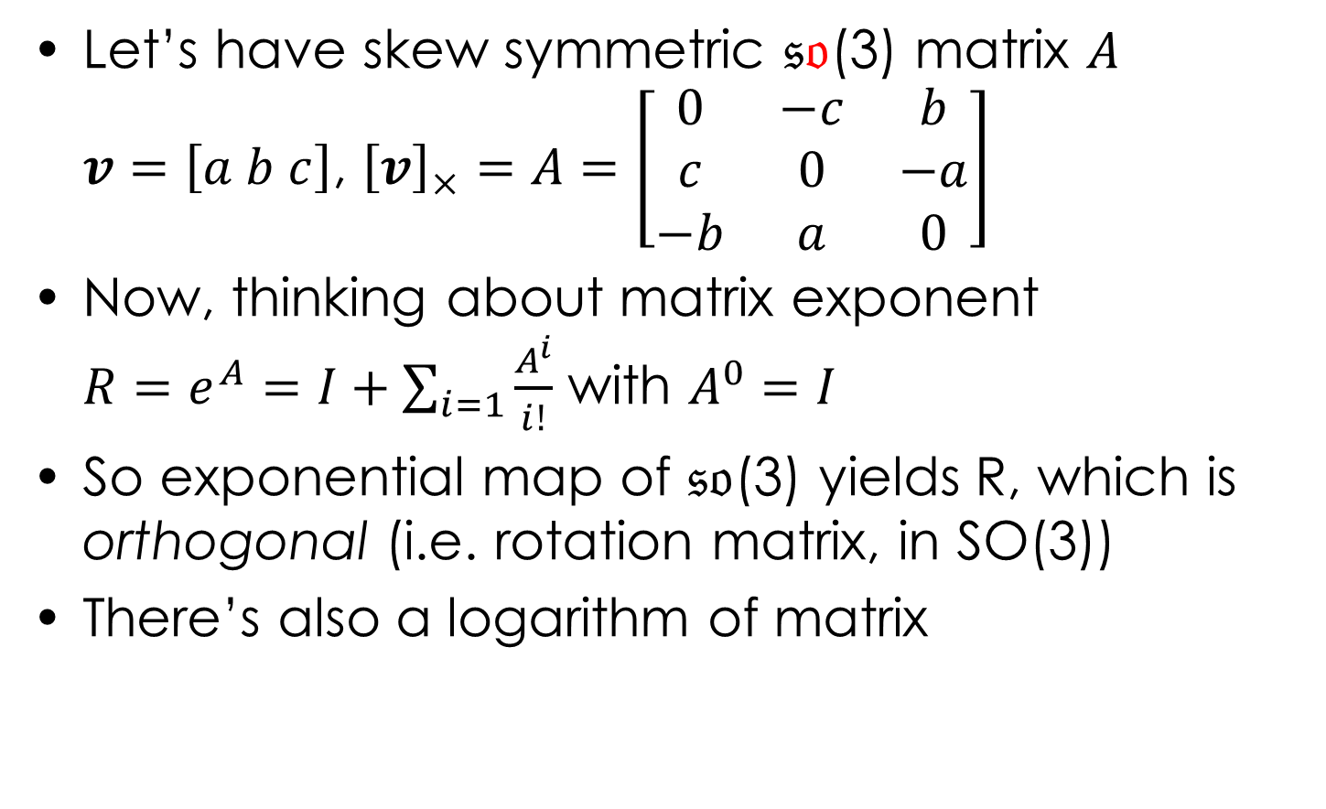
Lie Group Basics
Let’s have skew symmetric 𝔰𝔬(3) matrix $A$
$v=\left[a b c\right]$, ${\left[v\right]}_{×}=A=\left[\begin{matrix}0 & −c & b \\ c & 0 & −a \\ −b & a & 0\end{matrix}\right]$
Now, thinking about matrix exponent
$R=e^{A}=I+\sum_{i=1}{\frac{A^{i}}{i!}}$ with $A^{0}=I$
So exponential map of 𝔰𝔬(3) yields R, which is orthogonal (i.e. rotation matrix, in SO(3))
There’s also a logarithm of matrix

Slide 51

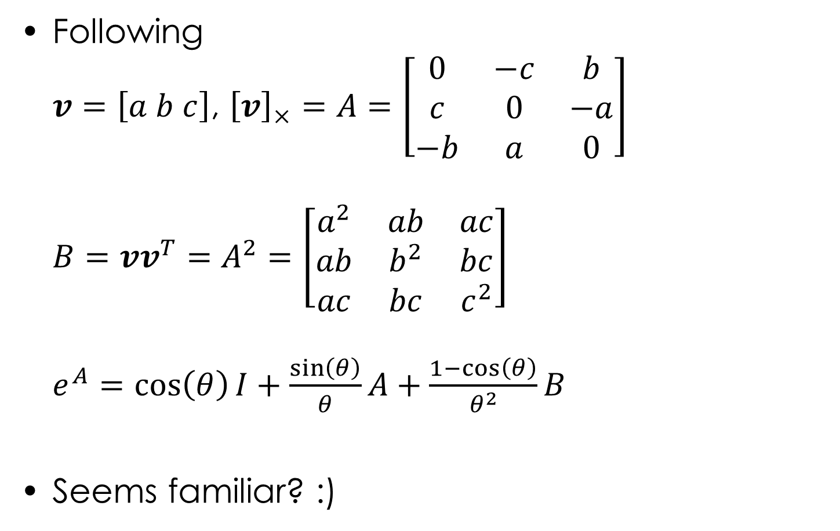
SO(3) Exponential Map
Following
$v=\left[a b c\right]$, ${\left[v\right]}_{×}=A=\left[\begin{matrix}0 & −c & b \\ c & 0 & −a \\ −b & a & 0\end{matrix}\right]$
$B=vv^{T}=A^{2}=\left[\begin{matrix}a^{2} & ab & ac \\ ab & b^{2} & bc \\ ac & bc & c^{2}\end{matrix}\right]$
$e^{A}=\cos\left(θ\right)I+\frac{\sin\left(θ\right)}{θ}A+\frac{1−\cos\left(θ\right)}{θ^{2}}B$
Seems familiar? :)

Slide 52
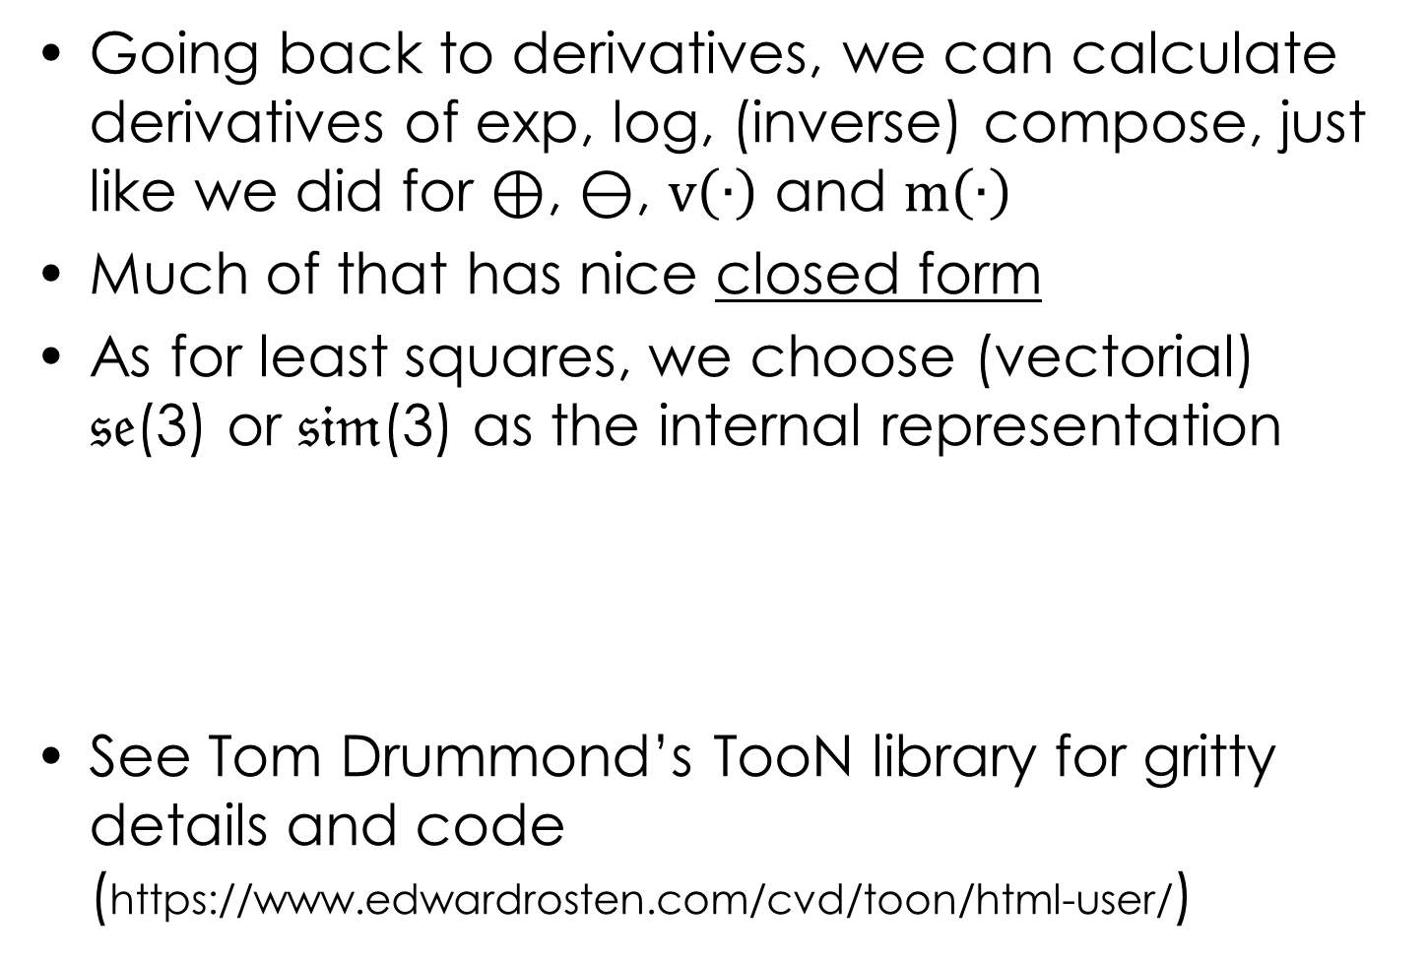
Lie Group Basics
Going back to derivatives, we can calculate derivatives of exp, log, (inverse) compose, just like we did for $⊕$, $⊖$, $\text{v}\left(∙\right)$ and $\text{m}\left(∙\right)$
Much of that has nice closed form
As for least squares, we choose (vectorial)
𝔰𝔢(3) or 𝔰𝔦𝔪(3) as the internal representation
See Tom Drummond’s TooN library for gritty details and code (https://www.edwardrosten.com/cvd/toon/html-user/)

Slide 53
Back to bundling
And now …

Slide 54
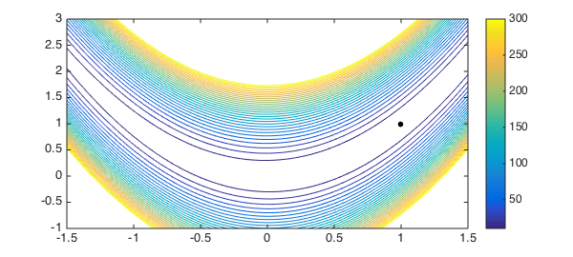
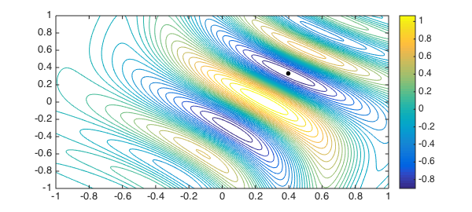
Handling Severe Nonlinearity
Gauss-Newton only computes step from local gradient, never looks back
Rosenbrock
Chebyshev
This would happen more with gradient descent. This is illustrative.

Slide 55
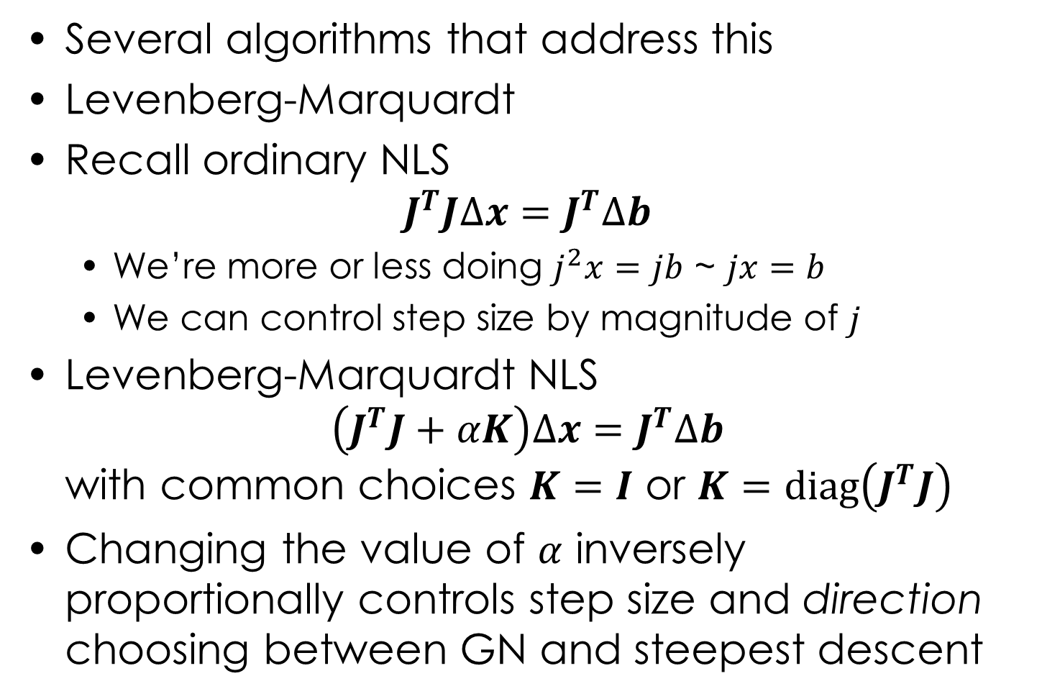
Handling Severe Nonlinearity
Several algorithms that address this
Levenberg-Marquardt
Recall ordinary NLS
$J^{T}J∆x=J^{T}∆b$
  We’re more or less doing $j^{2}x=jb$ ~ $jx=b$
  We can control step size by magnitude of $j$
Levenberg-Marquardt NLS
$\left(J^{T}J+αK\right)∆x=J^{T}∆b$
with common choices $K=I$ or $K=\text{diag}\left(J^{T}J\right)$
Changing the value of $α$ inversely proportionally controls step size and direction choosing between GN and steepest descent

Slide 56
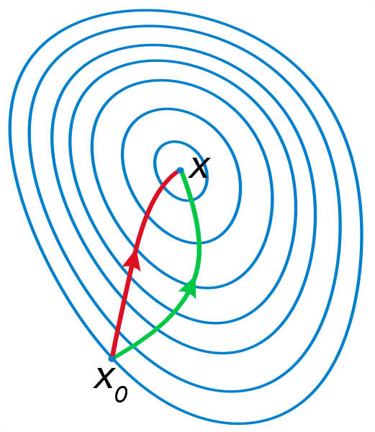
Gauss & Newton Descending a Really Steep Gradient, Holding Hands
GN typically
converges faster
GD less prone
to get stuck but
tends to zigzag
a lot
GN
GD

Slide 57
Gauss & Newton Descending a Really Steep Gradient, Holding Hands
GN typically
converges faster
GD less prone
to get stuck but
tends to zigzag
a lot
GN
GD

Slide 58
Effects of Levenberg-Marquardt Damping
O = [0 1; 1 3; 2 3; 3 7]; % we are trying to estimate b = p + pqa + pqra^2
% observations of some 1D function % where x = [p q r] is our unknown
% O is vector of pairs arg. a and desired fit b % h(x) = p + pqa + pqra^2, J = dh(x) / dx = [1+qa+qra^2, pa+pra^2, qa^2]
% we use this parameterization to make it nonlinear (would work with linear
x = [1 -1 -.1]'; % too but would be able to optimize in a single step, which would be boring)
% guess ⁰x (deliberately a bad guess, to take a few steps)
plot(O(:, 1), O(:, 2), '*k') % plot a-s, b-s
hold on
xx = linspace(min(O(:, 1)) - .5, max(O(:, 1)) + .5);
for i = 1:100
yy = x(1) + x(1) * x(2) * xx + x(1) * x(2) * x(3) * (xx.^2);
plot(xx, yy, '-b') % plot the initial guess
% evaluate the initial guess
J = [1 + x(2) * O(:, 1) + x(2) * x(3) * O(:, 1).^2, ...
x(1) * O(:, 1) + x(1) * x(3) * O(:, 1).^2, x(1) * x(2) * O(:, 1).^2];
% calculate the Jacobian
db = O(:,2) - x(1) - O(:,1) * x(1) * x(2) - O(:,1).^2 * x(1) * x(2) * x(3);
% calculate current error vector
dx = (J' * J + 0 * eye(size(J, 2))) \ J' * db; norm_dx = norm(dx)
% solve
if(norm_dx < 1e-6) % see if we optimize
break
end
x = x + dx % increment
end
yy = x(1) + x(1) * x(2) * xx + x(1) * x(2) * x(3) * (xx.^2);
plot(xx, yy, '-r') % plot the final in red
hold off

Slide 59
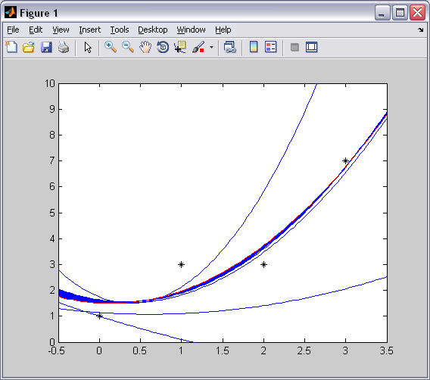
Effects of Levenberg-Marquardt Damping
O = [0 1; 1 3; 2 3; 3 7]; % we are trying to estimate b = p + pqa + pqra^2
% observations of some 1D function % where x = [p q r] is our unknown
% O is vector of pairs arg. a and desired fit b % h(x) = p + pqa + pqra^2, J = dh(x) / dx = [1+qa+qra^2, pa+pra^2, qa^2]
% we use this parameterization to make it nonlinear (would work with linear
x = [1 -1 -.1]'; % too but would be able to optimize in a single step, which would be boring)
% guess ⁰x (deliberately a bad guess, to take a few steps)
plot(O(:, 1), O(:, 2), '*k') % plot a-s, b-s
hold on
xx = linspace(min(O(:, 1)) - .5, max(O(:, 1)) + .5);
for i = 1:100
yy = x(1) + x(1) * x(2) * xx + x(1) * x(2) * x(3) * (xx.^2);
plot(xx, yy, '-b') % plot the initial guess
% evaluate the initial guess
J = [1 + x(2) * O(:, 1) + x(2) * x(3) * O(:, 1).^2, ...
x(1) * O(:, 1) + x(1) * x(3) * O(:, 1).^2, x(1) * x(2) * O(:, 1).^2];
% calculate the Jacobian
db = O(:,2) - x(1) - O(:,1) * x(1) * x(2) - O(:,1).^2 * x(1) * x(2) * x(3);
% calculate current error vector
dx = (J' * J + 1 * eye(size(J, 2))) \ J' * db; norm_dx = norm(dx)
% solve
if(norm_dx < 1e-6) % see if we optimize
break
end
x = x + dx % increment
end
yy = x(1) + x(1) * x(2) * xx + x(1) * x(2) * x(3) * (xx.^2);
plot(xx, yy, '-r') % plot the final in red
hold off

Slide 60
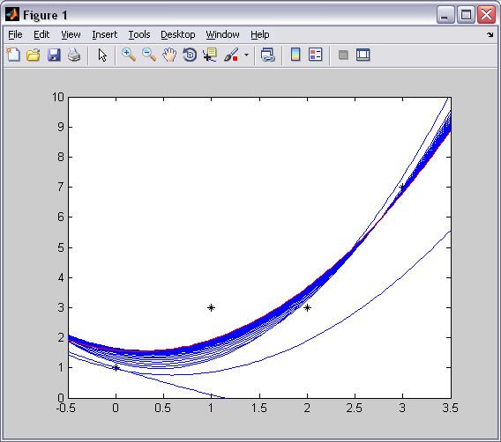
Effects of Levenberg-Marquardt Damping
O = [0 1; 1 3; 2 3; 3 7]; % we are trying to estimate b = p + pqa + pqra^2
% observations of some 1D function % where x = [p q r] is our unknown
% O is vector of pairs arg. a and desired fit b % h(x) = p + pqa + pqra^2, J = dh(x) / dx = [1+qa+qra^2, pa+pra^2, qa^2]
% we use this parameterization to make it nonlinear (would work with linear
x = [1 -1 -.1]'; % too but would be able to optimize in a single step, which would be boring)
% guess ⁰x (deliberately a bad guess, to take a few steps)
plot(O(:, 1), O(:, 2), '*k') % plot a-s, b-s
hold on
xx = linspace(min(O(:, 1)) - .5, max(O(:, 1)) + .5);
for i = 1:100
yy = x(1) + x(1) * x(2) * xx + x(1) * x(2) * x(3) * (xx.^2);
plot(xx, yy, '-b') % plot the initial guess
% evaluate the initial guess
J = [1 + x(2) * O(:, 1) + x(2) * x(3) * O(:, 1).^2, ...
x(1) * O(:, 1) + x(1) * x(3) * O(:, 1).^2, x(1) * x(2) * O(:, 1).^2];
% calculate the Jacobian
db = O(:,2) - x(1) - O(:,1) * x(1) * x(2) - O(:,1).^2 * x(1) * x(2) * x(3);
% calculate current error vector
dx = (J' * J + 10 * eye(size(J, 2))) \ J' * db; norm_dx = norm(dx)
% solve
if(norm_dx < 1e-6) % see if we optimize
break
end
x = x + dx % increment
end
yy = x(1) + x(1) * x(2) * xx + x(1) * x(2) * x(3) * (xx.^2);
plot(xx, yy, '-r') % plot the final in red
hold off

Slide 61
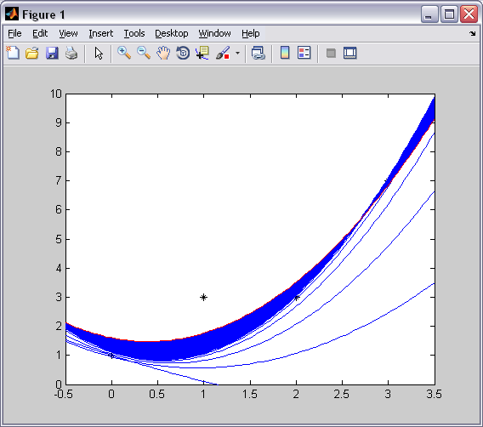
Effects of Levenberg-Marquardt Damping
O = [0 1; 1 3; 2 3; 3 7]; % we are trying to estimate b = p + pqa + pqra^2
% observations of some 1D function % where x = [p q r] is our unknown
% O is vector of pairs arg. a and desired fit b % h(x) = p + pqa + pqra^2, J = dh(x) / dx = [1+qa+qra^2, pa+pra^2, qa^2]
% we use this parameterization to make it nonlinear (would work with linear
x = [1 -1 -.1]'; % too but would be able to optimize in a single step, which would be boring)
% guess ⁰x (deliberately a bad guess, to take a few steps)
plot(O(:, 1), O(:, 2), '*k') % plot a-s, b-s
hold on
xx = linspace(min(O(:, 1)) - .5, max(O(:, 1)) + .5);
for i = 1:100
yy = x(1) + x(1) * x(2) * xx + x(1) * x(2) * x(3) * (xx.^2);
plot(xx, yy, '-b') % plot the initial guess
% evaluate the initial guess
J = [1 + x(2) * O(:, 1) + x(2) * x(3) * O(:, 1).^2, ...
x(1) * O(:, 1) + x(1) * x(3) * O(:, 1).^2, x(1) * x(2) * O(:, 1).^2];
% calculate the Jacobian
db = O(:,2) - x(1) - O(:,1) * x(1) * x(2) - O(:,1).^2 * x(1) * x(2) * x(3);
% calculate current error vector
dx = (J' * J + 100 * eye(size(J, 2))) \ J' * db; norm_dx = norm(dx)
% solve
if(norm_dx < 1e-6) % see if we optimize
break
end
x = x + dx % increment
end
yy = x(1) + x(1) * x(2) * xx + x(1) * x(2) * x(3) * (xx.^2);
plot(xx, yy, '-r') % plot the final in red
hold off

Slide 62
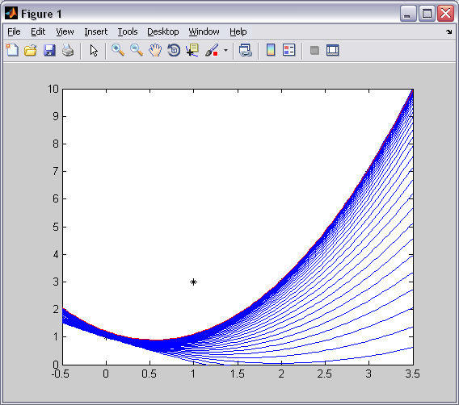
Effects of Levenberg-Marquardt Damping
O = [0 1; 1 3; 2 3; 3 7]; % we are trying to estimate b = p + pqa + pqra^2
% observations of some 1D function % where x = [p q r] is our unknown
% O is vector of pairs arg. a and desired fit b % h(x) = p + pqa + pqra^2, J = dh(x) / dx = [1+qa+qra^2, pa+pra^2, qa^2]
% we use this parameterization to make it nonlinear (would work with linear
x = [1 -1 -.1]'; % too but would be able to optimize in a single step, which would be boring)
% guess ⁰x (deliberately a bad guess, to take a few steps)
plot(O(:, 1), O(:, 2), '*k') % plot a-s, b-s
hold on
xx = linspace(min(O(:, 1)) - .5, max(O(:, 1)) + .5);
for i = 1:100
yy = x(1) + x(1) * x(2) * xx + x(1) * x(2) * x(3) * (xx.^2);
plot(xx, yy, '-b') % plot the initial guess
% evaluate the initial guess
J = [1 + x(2) * O(:, 1) + x(2) * x(3) * O(:, 1).^2, ...
x(1) * O(:, 1) + x(1) * x(3) * O(:, 1).^2, x(1) * x(2) * O(:, 1).^2];
% calculate the Jacobian
db = O(:,2) - x(1) - O(:,1) * x(1) * x(2) - O(:,1).^2 * x(1) * x(2) * x(3);
% calculate current error vector
dx = (J' * J + 1000 * eye(size(J, 2))) \ J' * db; norm_dx = norm(dx)
% solve
if(norm_dx < 1e-6) % see if we optimize
break
end
x = x + dx % increment
end
yy = x(1) + x(1) * x(2) * xx + x(1) * x(2) * x(3) * (xx.^2);
plot(xx, yy, '-r') % plot the final in red
hold off

Slide 63
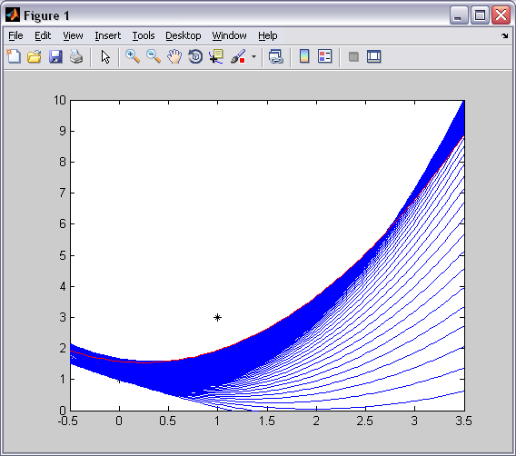
Effects of Levenberg-Marquardt Damping
O = [0 1; 1 3; 2 3; 3 7]; % we are trying to estimate b = p + pqa + pqra^2
% observations of some 1D function % where x = [p q r] is our unknown
% O is vector of pairs arg. a and desired fit b % h(x) = p + pqa + pqra^2, J = dh(x) / dx = [1+qa+qra^2, pa+pra^2, qa^2]
% we use this parameterization to make it nonlinear (would work with linear
x = [1 -1 -.1]'; % too but would be able to optimize in a single step, which would be boring)
% guess ⁰x (deliberately a bad guess, to take a few steps)
plot(O(:, 1), O(:, 2), '*k') % plot a-s, b-s
hold on
xx = linspace(min(O(:, 1)) - .5, max(O(:, 1)) + .5);
for i = 1:1000
yy = x(1) + x(1) * x(2) * xx + x(1) * x(2) * x(3) * (xx.^2);
plot(xx, yy, '-b') % plot the initial guess
% evaluate the initial guess
J = [1 + x(2) * O(:, 1) + x(2) * x(3) * O(:, 1).^2, ...
x(1) * O(:, 1) + x(1) * x(3) * O(:, 1).^2, x(1) * x(2) * O(:, 1).^2];
% calculate the Jacobian
db = O(:,2) - x(1) - O(:,1) * x(1) * x(2) - O(:,1).^2 * x(1) * x(2) * x(3);
% calculate current error vector
dx = (J' * J + 1000 * eye(size(J, 2))) \ J' * db; norm_dx = norm(dx)
% solve
if(norm_dx < 1e-6) % see if we optimize
break
end
x = x + dx % increment
end
yy = x(1) + x(1) * x(2) * xx + x(1) * x(2) * x(3) * (xx.^2);
plot(xx, yy, '-r') % plot the final in red
hold off

Slide 64

Levenberg-Marquardt
To control step size, use optimization gain
$g\left(∆x\right)=\frac{S\left(x\right)−S\left(x+∆x\right)}{L\left(0\right)−L\left(∆x\right)}$
with linear model error $L\left(∆x\right)=\frac{1}{2}{\left\|h\left(x\right)+J∆x\right\|}^{2}$ and squared error $S\left(\hat{x}\right)=\sum{{h\left(\hat{x}\right)}^{2}}$
If the gain is positive, take the step, reduce $α$
If the gain is negative, keep the current linearization and increase $α$ at exponential rate with each failed step
See [Madsen, 1999, Methods for NLS Problems] for further details

Slide 65

Pop Quiz Interlude
Quick, shout answer to win sausage!
Mike Powell was:
  Cat lady
  Hotdog eating champion
  Golfer
  Computer Scienceman

Slide 66



Dogleg optimizer
Powell’s Dogleg (there’s also subspace Dogleg)

Slide 67


Powell’s Dogleg Optimizer
Change gradient direction based on magnitude of $∆x$, generate step of specified size
In solving the ordinary normal equation
$J^{T}J∆x_{GN}=J^{T}∆b$ we can recover $∆x_{GN}$ and also $∆x_{SD}=g\frac{{\left\|g\right\|}^{2}}{{\left\|Jg\right\|}^{2}}$ with $g=−J^{T}∆b$
Δx_{SD}
between
trust radius
GN small
Δx_{GN}
Δx_{GN}
Δx_{SD}
Δx_{SD}
Δx_{GN}
SD large

Slide 68

Powell’s Dogleg Optimizer
Formally, for trust radius $⍙$, the step is
$∆x_{DL}=\left\{\begin{matrix}∆x_{GN} & if \left\|∆x_{GN}\right\|≤⍙ \\ {⍙∙{∆x}_{SD}}/{\left\|∆x_{SD}\right\|} & if \left\|∆x_{SD}\right\|≥⍙ \\ {∆x}_{SD}+β\left(∆x_{GN}−{∆x}_{SD}\right) & otherwise\end{matrix}\right.$
where $β=\frac{−b+\sqrt{b^{2}−4ac}}{2a}$ with $a={\left\|∆x_{GN}−∆x_{SD}\right\|}^{2}$, $b={∆x_{SD}}^{T}\left(∆x_{GN}−∆x_{SD}\right)$ and $c={\left\|∆x_{SD}\right\|}^{2}−⍙^{2}$
$⍙$ is changed based on optimization gain
The initial trust radius can be large (unlike LM, DL does not resolve the lin. system on bad step)

Slide 69
Handling Outliers – Robust Estimation
Outliers are a problem in computer vision
  Bad feature matching (mismatched feature)
  Reflections (matched to a good feature in a mirror)
  Moving objects (cars, pedestrians, wind)
Can try to reject suspicious observations
Can use robust estimation

Slide 70

Robust Estimation
Try to identify outliers in the LS framework
LS minimize squared error
$x={argmin}_{x}\frac{1}{2}\sum{{\left(b−h\left(x\right)\right)}^{2}}$
big outliers have huge (squared) influence
Try to generalize the error
$x={argmin}_{x}\sum{ρ}\left(b−h\left(x\right)\right)$
where $ρ\left(u\right)=\frac{1}{2}u^{2}$ is ordinary LS loss function

Slide 71


Robust Estimation
Try to minimize pseudo-L1 error
$$ρ\left(u\right)=\left\{\begin{matrix}\frac{1}{2}u^{2} & if \left|u\right|≤a \\ \frac{1}{2}a\left(2\left|u\right|−a\right) & otherwise\end{matrix}\right.$$
Huber kernel

Slide 72

Normal Equations for Robust Estimation
So how to plug it in? Notice that for LS, $ρ\left(u\right)=\frac{1}{2}u^{2}$ and $ρ^{′}\left(u\right)=1$
The derivative of loss is score function $ψ{\left(u\right)=ρ}^{′}\left(u\right)$
This can be used for weights,
$J^{T}WJ∆x_{GN}=J^{T}W∆b$
where $W=diag\left(\frac{ψ\left(u\right)}{u}\right)$
Let’s try setting $u=∆b$

Slide 73

Robust Least Squares Demo (Matlab)
O = [0 1; 1 3; 2 3; 2.5 4.9; 3 7];
% observations of some 1D function
% O(:,1) are the arguments, a
% O(:,2) are the desired fit values, b
a = 1.345;
% guess some parameter for outlier rejection
for i = 1:10
J = … % calculate the Jacobian
db = … % calculate current error vector
w = zeros(length(db), 1);
for j = 1:length(db)
u = db(j);
if(abs(u) <= a)
w(j) = 1 / u; % resolve division by zero
else
w(j) = a * sign(u) / u;
end
end
W = diag(w); % calculate the robust weights
dx = (J' * W * J) \ J' * W * db;
% solve normal equation (backslash = solve)
end
% [plot stuff]

Slide 74

Solving Overfitting / Scale Problems
Now we‘re overfitting, the points at the bottom are all treated as outliers
Changing the value of $a$ is a temporary solution
We need to approximate scale of the problem
MAD (median absolute deviation)
$s=1.4826 med\left(abs\left(∆b\right)\right)$
Now set $u=\frac{∆b}{s}$
Alternative to MAD - Huber‘s second proposal

Slide 75

Robust Least Squares Demo (Matlab)
O = [0 1; 1 3; 2 3; 2.5 4.9; 3 7];
% observations of some 1D function
% O(:,1) are the arguments, a
% O(:,2) are the desired fit values, b
a = 1.345;
% guess some parameter for outlier rejection
for i = 1:10
% [calculate J, db]
MAD = median(abs(db));
s = 1.4826 * MAD;
% calculate MAD
w = zeros(length(db), 1);
for j = 1:length(db)
u = db(j) / s; % apply scale
if(abs(u) <= a)
w(j) = 1 / u; % resolve division by zero
else
w(j) = a * sign(u) / u;
end
end
W = diag(w); % calculate the robust weights
% [solve]
end
% [plot stuff]

Slide 76

Robust Least Squares Demo (Matlab)
O = [0 1; 1 7; 2 3; 2.5 4.9; 3 7]; % turrn the second point into an OUTLIER
% observations of some 1D function
% O(:,1) are the arguments, a
% O(:,2) are the desired fit values, b
a = 1.345;
% guess some parameter for outlier rejection
for i = 1:10
% [calculate J, db]
MAD = median(abs(db));
s = 1.4826 * MAD;
% calculate MAD
w = zeros(length(db), 1);
for j = 1:length(db)
u = db(j) / s; % apply scale
if(abs(u) <= a)
w(j) = 1 / u; % resolve division by zero
else
w(j) = a * sign(u) / u;
end
end
W = diag(w); % calculate the robust weights
% [solve]
end
% [plot stuff]

Slide 77

More About Robust Kernels
What are the magic numbers (1.4826, 1.345)?
Relative estimator efficiency
$e=\frac{E\left({\left(T_{2}−x\right)}^{2}\right)}{E\left({\left(T_{1}−x\right)}^{2}\right)}$
where $x$ is true solution, $E\left(∙\right)$ is expectation
Typically compare to NLS, set efficiency to 95%

Slide 78

More About Robust Kernels
Are there other kernel types?

Slide 79

Intermezzo II
And now for something completely different …

Slide 80

Solving Linear Systems
NLS boils down to solving linearized system
$J^{T}J∆x=J^{T}∆b$
  Most of time is spent there
  In the remainder, let‘s assume $Λx=b$
  In here, $Λ$ is sparse (most of its entries are zero) but many of the methods apply to dense matrices too

Slide 81
Solving Linear Systems
Different methods
  Direct methods - reduce the matrix to triangular
    Proven complexity, mature algorithms
    Need considerable amounts of memory
  Iterative methods - do a lot of vector math, iteratively converge to the solution
    Needs very little memory
    Convergence depends on problem, preconditioner
    Quite young field, not much proven
  Subspace methods - use Eigenvalue-like algorithms to calculate subspace approximations, solve there
[Davis, 2006, Direct Methods for Sparse Systems]
[Saad, 2003, Iterative Methods for Sparse Systems]

Slide 82

Direct Methods Primer
Consider the two following systems
$\left[ \begin{matrix}1 & 7 & 5 \\ 1 & 5 & 1 \\ 1 & 2 & 1\end{matrix} \right]∙x=\left[ \begin{matrix}9 \\ 6 \\ 9\end{matrix} \right]$
$\left[ \begin{matrix}1 & 7 & 5 \\ 0 & −2 & −4 \\ 0 & 0 & 6\end{matrix} \right]∙x=\left[ \begin{matrix}9 \\ −3 \\ 7.5\end{matrix} \right]$
In both cases, $x=\left[9.75, −1, 1.25\right]$
What happened?
Pivoting for stability, cost. Only one r.h.s.

Slide 83
Gaussian Elimination, Backsubstitution
A = round(rand(3,3) * 10)
b = round(rand(3,1) * 10)
n = length(A);
for k=1:n-1
for i=k+1:n
x = A(i,k) / A(k,k);
A(i,k+1:n) = A(i,k+1:n) - x * A(k,k+1:n); % row combine
A(i,k) = 0; % we just eliminated it
b(i) = b(i) - x * b(k);
end
end
A
b
% Gaussian elimination
x = zeros(n,1);
for i=n:-1:1 % loop backwards
r = b(i) - dot(A(i,i+1:n), x(i+1:n)');
x(i) = r / A(i, i);
end
x
% back-substitution

Slide 84

LU decomposition
Another old method
Factorize $Λ=LU$
  $L$ being lower triangular with unit diagonal
  $U$ being upper triangular
To solve $Λx=LUx=b$ (and so $Ux=L^{−1}b$)
  First solve L$y=b$ forward substitution w/o div
  Then solve $Ux=y$ back-substitution
To work, $Λ$ must be square, invertible
Will require pivoting for stability
  Partial $PΛ=LU$ (reorder rows)
  Full $PΛQ=LU$ (reorder rows, cols)

Slide 85
LU decomposition
A = round(rand(3,3) * 10)
LU = A; % works in-place
for k = 1:n
LU(k+1:n, k) = LU(k+1:n, k) / LU(k, k);
% divide by pivot (modifies the rest of this column)
for i = k+1:n
x = LU(i, k);
for j = k+1:n % explicit loop intended
LU(i, j) = LU(i, j) - x * LU(k, j); % causes fill-in in sparse version
end
% reduce the rest of the matrix
end
% modify the lower-right submatrix
end
U = triu(LU)
L = tril(LU, -1) + eye(size(LU))
% unpack to L and U, add identity diagonal to L

Slide 86



LU decomposition
Several variants, based on ordering of loops i j k
kji
read
write
kij

Slide 87


LU decomposition
In sparse version, we care about fill-in
Depends on order of rows / columns
A
L+U

Slide 88

AMD Ordering
Approximate Minimum Degree [Amestoy 2004]

Slide 89

Enter Captcha If Youre awake

Slide 90

Cholesky factorization
Factorize $Λ=R^{T}R$
  $R$ being upper triangular,
  with positive diagonal entries
To solve $Λx=R^{T}Rx=b$
  First solve $R^{T}y=b$ forward substitution
  Then solve $Rx=y$ back-substitution
To work, $Λ$ must be square, symmetric and positive-definite (SPD)
  NLS matrices are (up to numerical precision)
  Adding small damping on the diagonal usually helps
  Modified Cholesky factorization
Does not need pivoting

Slide 91
Cholesky factorization
A = round(rand(3,3) * 10);
A = A' * A + eye(size(A)) * 10 % try to make it SPD
R = zeros(size(A));
for j = 1:n % for every column
for k = 1:j-1 % for all prev cols that are nnz at row j (know those from etree)
s = 0;
for i = 1:k-1 % for all blocks above the diagonal in the prev column
s = s + R(i, k) * R(i, j); % takes elements from two different columns
end
% cmod; causes fill-in in the current column
R(k, j) = (A(k, j) - s) / R(k, k); % accesses upper diagonal of A
end
s = R(1:j-1, j)' * R(1:j-1, j);
R(j, j) = sqrt(A(j, j) - s); % must be positive (or modified Cholesky)
% cdiv
end

Slide 92
Sparse Cholesky
Elimination tree theory
  Calculate tree that drives loops in the factorization
  Saves time
  Particular orderings also yield elimination trees with independent and balanced subtrees (parallelism)
Supernodal Cholesky
  Sometimes, several columns in the factorization have identical nonzero structure - supernodes
  Treating supernodes as dense allows parallelism, GPU acceleration
Multifrontal Cholesky
  Frontal matrices, conceptually similar to supernodes

Slide 93

Cholesky factorization - AMD again

Slide 94

QR decomposition
Relatively new method (in the 60‘s)
Factorize $A=QR$
  $A$ can now be rectangular
  $Q$ being orthogonal ($Q^{T}=Q^{−1}$)
  $R$ being upper triangular (zero rows at the bottom)
To solve $Ax=QRx=b$
  First solve $y=Q^{T}b$ multiplication*
  Then solve $Rx=y$ back-substitution
No pivoting needed
Fill-in depends on column ordering only
  Out-of-core methods

Slide 95
Computing QR decomposition
Similar to Gaussian elimination
Householder reflections
  Compute a reflection about a plane (mirror matrix) that zeroes a lower part of a column in R
  Minor tricks (sign choice) for numerical stability
  Record reflections rather than representing Q
Givens rotations
  Compute rotation matrix that zeros one element in R
  Record rotation chains rather than representing Q

Slide 96





QR decomposition
Householder reflections
$$\left[\begin{matrix}ux & vx \\ uy & vy\end{matrix}\right]$$
$$\left[\begin{matrix}u′x & v′x \\ 0 & v′y\end{matrix}\right]$$
$$\left[\begin{matrix}ux & vx \\ uy & vy\end{matrix}\right]$$
$$\left[\begin{matrix}u′x & v′x \\ 0 & v′y\end{matrix}\right]$$

Slide 97

Slide stolen from Michael Heath‘s lecture

Slide 98

Slide stolen from Michael Heath‘s lecture

Slide 99

QR decomposition
Related to Cholesky
  $A=QR$
  $Λ=A^{T}A$
  $Λ=R^{T}Q^{T}QR=R^{T}R$
  $R$ is the same as in Cholesky factorization, up to the sign of the rows (Cholesky always has positive diag)
Can directly solve NLS on $J$ without forming $J^{T}J$
  $J=QR$
  $R∆x=Q^{T}∆b$
  Numerical benefits

Slide 100
Householder QR Demo (Matlab)
M = round(rand(5, 3) * 10)
[m n] = size(M);
Q = eye(m, m); % crime against QR: explicit Q
R = M; % works inplace
elim = min(m - 1, n); % decide how many cols to eliminate to get triangular R
for i = 1:elim
Aii = R(i, i);
Ai_norm = sqrt(R(i:m, i)' * R(i:m, i));
dii = abs(Ai_norm) * sign(sign(Aii) + 0.5); % !!! need zero-avoiding sign function !!!
wii = Aii - dii;
two_fi_inv_squared = -1 / (wii * dii);
% calculate Householder reflection of the i-th column
for j = i+1:n
fj = wii * R(i, j); % the head of column i is replaced by wii
fj = fj + R(i+1:m, i)' * R(i+1:m, j); % dot of lower-part of columns i and j
fj = fj * two_fi_inv_squared;
% calculate columns dot
R(i, j) = R(i, j) - fj * wii;
R(i+1:m, j) = R(i+1:m, j) - fj * R(i+1:m, i);
% update jth column
end
% apply Householder reflections also to the other columns to the right

Slide 101
Householder QR Demo (Matlab)
for j = 1:m
fj = wii * Q(j, i); % the head of column i is replaced by wii
fj = fj + Q(j, i+1:m) * R(i+1:m, i); % dot of lower-part of columns i and j
fj = fj * two_fi_inv_squared;
% calculate columns dot
Q(j, i) = Q(j, i) - fj * wii;
Q(j, i+1:m) = Q(j, i+1:m) - fj * R(i+1:m, i)';
% update jth column
end
% apply Householder reflections also to the r.h.s columns, in transpose!
R(i, i) = dii;
R(i+1:m, i) = 0; % finally, clear the rest of the current column
end
% eliminate lower triangle of M, column by column

Slide 102


Schur Complement Trick
In BA, it is possible to reorder the system to have diagonal submatrices
  bipartite ordering, MIS
Λ
PΛP⁻¹
92×6
57957×3
*The sparsity is the same on the left / right. The nnz‘s are just very inflated to be visible and that makes the sparsity appear different.

Slide 103


Schur Complement Trick
Then the matrix is partitioned as
$PΛP^{−1}=\left[\begin{matrix}A & U \\ U^{T} & D\end{matrix}\right]$
and the linear system $Λx=b$ partitioned as
$\left[\begin{matrix}A & U \\ U^{T} & D\end{matrix}\right]\left[\begin{matrix}p \\ l\end{matrix}\right]=\left[\begin{matrix}u \\ v\end{matrix}\right]$ with $\left[\begin{matrix}p \\ l\end{matrix}\right]=Px$ , $\left[\begin{matrix}u \\ v\end{matrix}\right]=Pb$
The Schur complement of A is $A−UD^{−1}U^{T}$
<1% nnz
92×6
>40% nnz
92×6

Slide 104

Schur Complement Trick
The linear system
$\left[\begin{matrix}A & U \\ U^{T} & D\end{matrix}\right]P^{−1}\left[\begin{matrix}p \\ l\end{matrix}\right]=P^{−1}\left[\begin{matrix}u \\ v\end{matrix}\right]$
can be solved as
$\left(A−UD^{−1}U^{T}\right)p=u−UD^{−1}v$
$l=D^{−1}\left(v−U^{T}p\right)$
92×6
57957×3

Slide 105

Schur Complement Trick

Slide 106
iterative methods?
Who will do seminar on

Slide 107
subspace methods?
Who will do seminar on

Slide 108
Back to bundling
And now …

Slide 109





Calculating Covariances
System covariances (variable covariances)
  Different from edge (observation) covariances
Obtained by inverting the information matrix Λ
  Inverse $Σ={\text{Λ}}^{−1}$ is fully dense
Λ

Slide 110
Calculating Covariances
Use Cholesky factorization & backsubstitution, keep only parts of the covariance to save memory
  The way Google‘s Ceres does it, gruesome performance
Use SVD
  Another dead end explored by Google™

Slide 111

Calculating Covariances
Use recursive formula for calculating only some parts of the inverse
$Σ_{ii}=\frac{1}{R_{ii}}\left(\frac{1}{R_{ii}}−\sum_{k=i+1,R_{ik}≠0}^{n}{R_{ik}Σ_{ki}}\right)$
$Σ_{ij}=\frac{1}{R_{ii}}\left(−\sum_{k=i+1,R_{ik}≠0}^{n}{R_{ik}Σ_{kj}}−\sum_{k=j+1,R_{ik}≠0}^{n}{R_{ik}Σ_{jk}}\right)$
[Björck, 1996, Numerical methods for least squares problems, SIAM]

Slide 112

Calculating Covariances
Use recursive formula for calculating only some parts of the inverse
[Ila, 2015, Fast Covariance Recovery in Incremental Nonlinear Least Square Solvers, ICRA]

Slide 113

Incremental Covariances
In SLAM, we often only have small increment
Updating covariance cheaper than recalculating from scratch
$∆Σ=\hat{Σ}{A_{u}}^{T}{\left(I−A_{u}\hat{Σ}{A_{u}}^{T}\right)}^{−1}A_{u}\hat{Σ}$
$∆Σ=−Σ{A_{u}}^{T}{\left(I+A_{u}Σ{A_{u}}^{T}\right)}^{−1}A_{u}Σ$
where $\hat{Λ}={\hat{A}}_{}^{T}\hat{A}=Λ+{A_{u}}^{T}A_{u}$ with $\hat{A}=A+A_{u}$
Need only a few elements of $\hat{Σ}$ (can use backsubstitution)
[Ila, 2015, Fast Covariance Recovery in Incremental Nonlinear Least Square Solvers, ICRA]

Slide 114

Visualizing Covariances

Slide 115


Are you still alive?
The end

